Slide 1
Using WEB Analytics for editorial decisions
September 12, 2016

Slide 2
Content
Training objectives
Definitions and metrics
Data and analysis
Audience
Usage Examples
Questions?

Slide 3
GOALS
Determine what you want to achieve and measure
Set and be aware of your goals
Notes:
Setting site goals (targets to achieve)

Slide 4
Goals
Why use analytics tools?
Understanding your audience
Making editorial decisions
Setting website goals
What do you want to achieve in one year?
Who do you target?
Current vs. Target audience

Slide 5
Current time Target audience

Slide 6
Tools, Data, Metrics
Tools
Google Analytics
Adobe Analytics
Parsely
Webtrends
Chartbeat (Real Time)
Metrics
Qualitative (engagement) and quantitative (reach)
Strong and weak metrics
Data evaluation

Slide 7
METRICS and What needs to be measured
Desktop and mobile devices
Visits/Sessions
Page/Views
Pages per Visit
Visit Duration
Bounce Rate
Audio/Video plays
Engagement/Interaction
Apps
Visits
Launches
Downloads
Audio/Video plays
Social Networks
Engagement
Likes
Shares
Comments
Audio/Video plays
Number of Followers/Fans

Slide 8
Metrics: most valuable metrics for journalists
Action |  | Metric
Visit a website View content | How many? How often? | Visits Page views Pages per Visit Audio/Video plays
Engage Interact | How much? How often? | Share Comment Take a poll Vote Download Send

Slide 9
Metrics: What is meaningful and useful to make decisions?
Strong quantitative metrics:
Visits and page views – show increase or decrease in traffic
Visit is counted every time someone comes to the website
During one visit occurs one or more page view
Additional dimensions/ break down:
Visit retention – how often users come to the website?
Visits from new vs. returning visitors
Visits by content (article, photo gallery, video, website section)
Visits by source of traffic (direct, referred from search engines, from social networks, partner websites)
Visits by demographics (country, city, time of the day, week)
Visits by other factors: device type (mobile, desktop), network, connection type, etc.

Slide 10
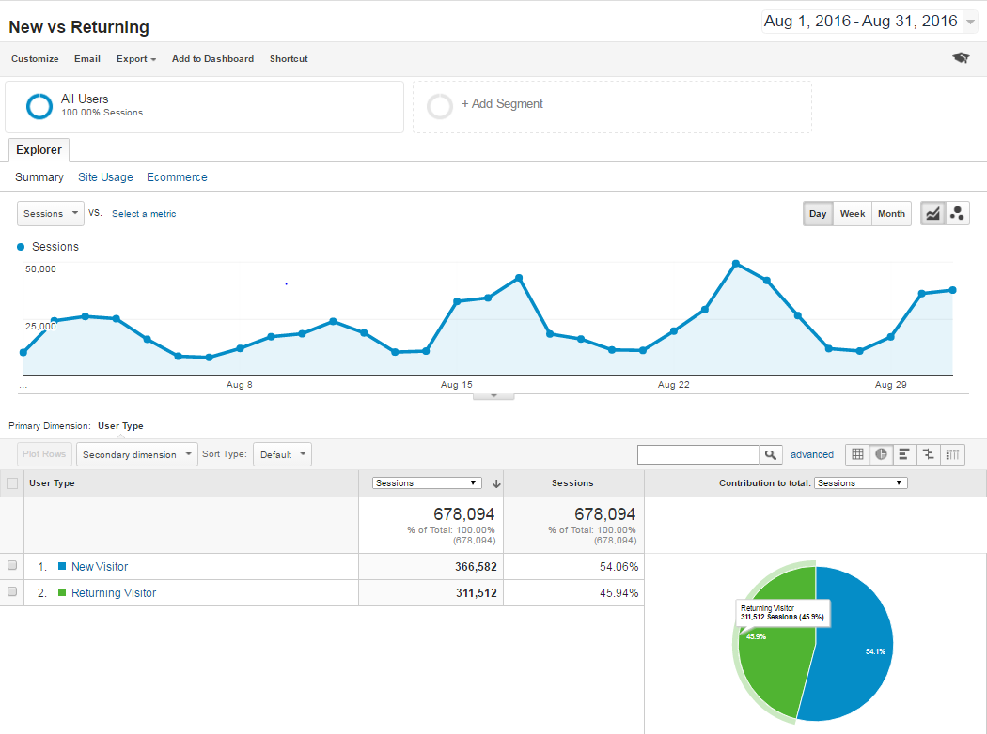
Is the website ATTRACTING new audiences?

Slide 11
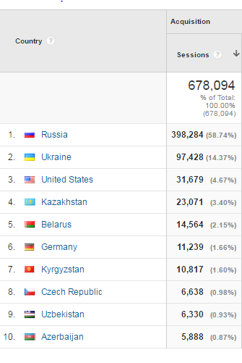
Where are visitors located?

Slide 12
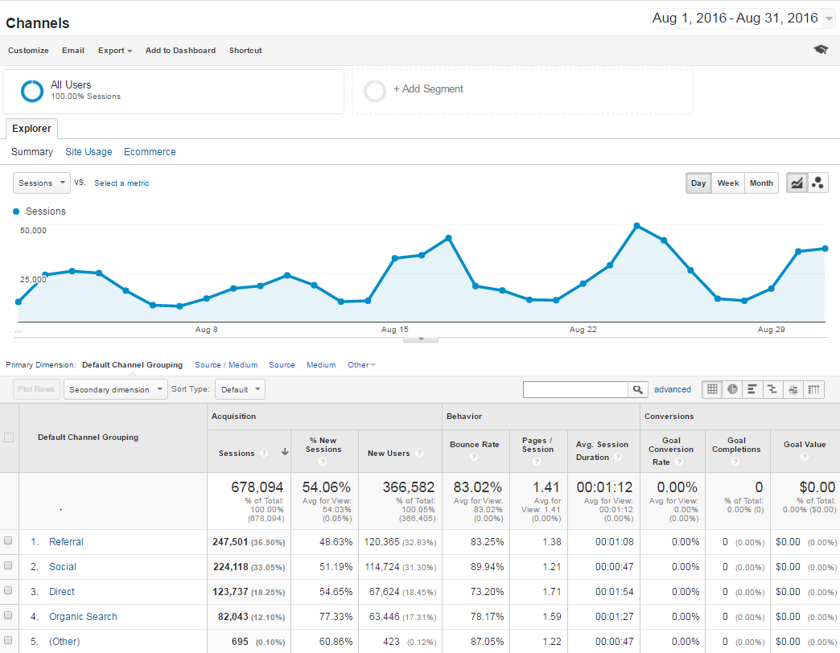
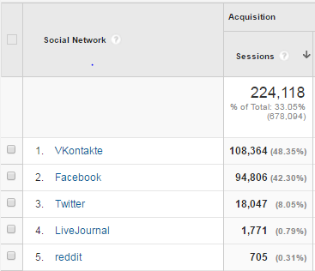
HOW IMPORTANT is TRAFFIC FROM SOCIAL NETWORKS?

Slide 13
Metrics: What is meaningful and useful to make decisions?
Strong quantitative metrics:
Audio/Video plays – show consumption of the multimedia offerings
Measure time spent watching / listening
Percentage of material watched / listened to
Can be broken down by other categories:
By content (audio, video, live program, title)
By source of traffic (direct, referred from search engines, from social networks, partner websites)
By demographics (country, city, time of the day, week)
By other factors: device type (mobile, desktop), network, connection type, etc.

Slide 14
Video consumption by title
Which videos were viewed most in the past month?
How much of the video was consumed?

Slide 15
Video consumption over time
When did the video spike?
Day of the week
Time of the day
Is it still popular?
Some videos live just 1 day. Others attract audiences for days or even weeks.

Slide 16
Metrics: What is meaningful and useful to make decisions?
Strong qualitative metrics:
Bounce rate – percent of one-page visits of the top landing page
Are visitors leaving after reading just one page (high bounce rate)
Are they clicking other content available (low bounce rate)
Pages per visit
How much content visitors consume during one visit
Visit duration – average time spent on the site
Did user stayed around the website for a reasonable time to consume content?
For how long they watched and listened available content?

Slide 17
Long viewing time, high bounce rate
Analyze several metrics at once
Long visit duration and high bounce rate
A lot of users viewed the article for quite a long time, but majority left the website right after watching.

Slide 18
VK USERS MOST Numerous, but not dedicated
Analyze several metrics at once
This article has a lot of page views, but 95% of users that came from VK leave the website after reading it.
Those referred from Google are more likely to stay and read further content.

Slide 19
Metrics: Weak and not meaningful
Weak metrics:
Unique visitors
Based on computer IP /cookie / browser
Easy to under or over count (one device and multiple users/browsers/apps, one user and multiple devices/browsers/apps)
Number of fans, reach (on social networks)
Are those fans engaging / interacting with the content?
Did they read the content or were just exposed to it?
App downloads
Are they using the app?
How often they launch the app?

Slide 20
Data Tracking
Regularly tracking data to make important decisions
Weekly/monthly/annualy tracking to see trends
Daily real-time watching to make ad-hoc editorial decisions
Analyzing spikes
One-time event
Launch of new section / program
Paid advertisement
Technical problem
Spike in referred traffic
An influential shared content on social network, viral content
New partner site for content exchange
Other reasons

Slide 21
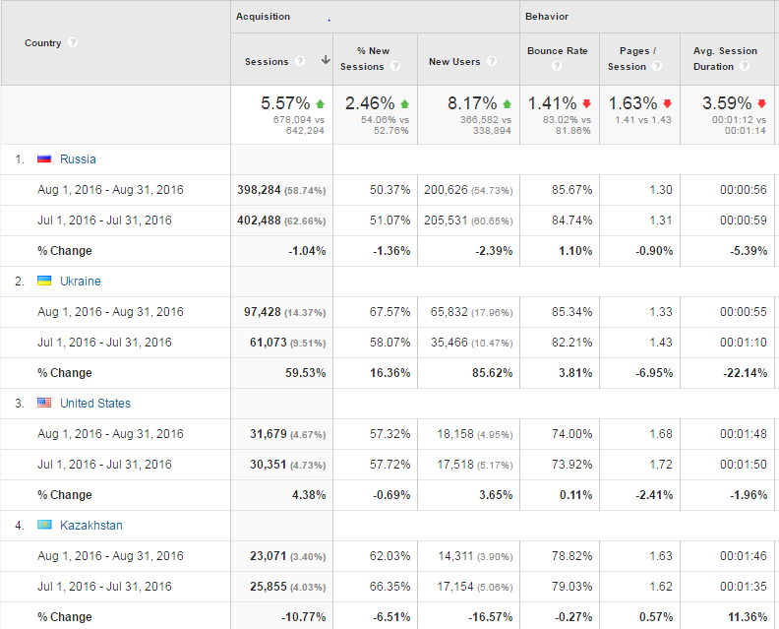
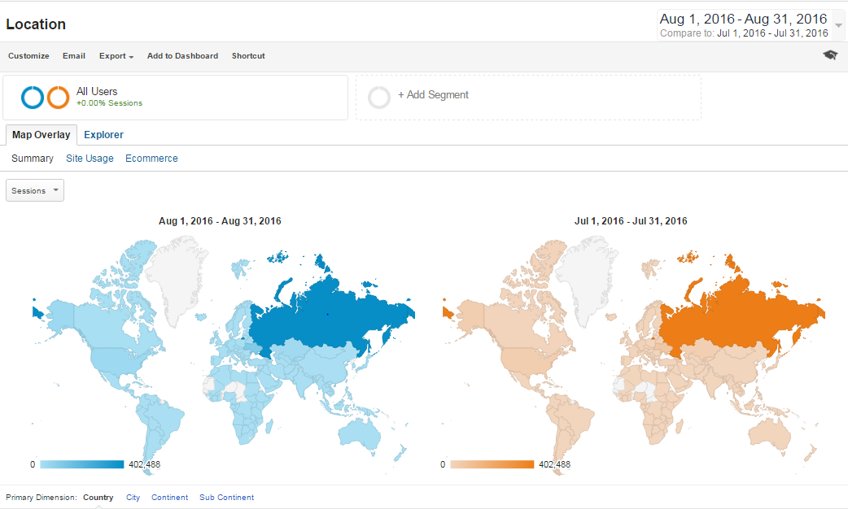
Increase in visits from Ukraine!!??
Did the cooperation with new partner website in Ukraine pay off?
Will the new audience be retained?

Slide 22
Analyzing data
 | Article / News item | Photo gallery | Live blog | Audio | Video | Live streaming
Sessions
Page views
Unique visitors
Shares
Sources of traffic
Comments
Plays
Bounce rate
Time on site
% consumed
Unique visitors
Visits

Slide 23
Analytical process
Make decisions
Monitor
Compare

Slide 24
Monitoring the Real-time dashboard
What is trending?
What are the top referrers?
Who are we reaching now?
Topics?
Keywords?
What story to cover next?
Are people sharing?

Slide 25
Making Decision with Data
Real-time monitoring
Move article on the homepage to display it more prominently or replace with other content
Rewrite headline or repackage a story
Decide to advertise / boost content on social networks
Change advertising target
Analyze traffic by audience type and trending topic
Adjust content to:
Reach new audiences
Retain current audiences
Extend visit duration
Increase engagement
Notes:
Decide if we will assign additional stories/coverage
Decide how prominently to display stories on the site
Help to determine how to write headlines
Help to design the website
Decide to reposition the story
Decide which stories to cover
Determine how to assign/deploy staffers
Rewrite the headline or repackage a story
Measure performance of employees

Slide 26
Making Decision with Data
Web Analytics trends monitoring
Monitor:
Weekly, monthly and annually to see performance trends
Compare:
Time periods to see growth or decline in traffic
Traffic sources to see market trends
Traffic by demographics to learn about audiences
New vs. retained audience after special events
Adjust content to:
Reach new audiences
Retain current audiences
Extend visit duration
Increase engagement

Slide 27
To achieve your goals
Based on the outcomes,
adjust content
Reach new audiences
Retain current audiences
Extend visit duration
Increase engagement
Improve journalism

Slide 28
THANK you!
Any questions?
Beata Grzelak
grzelakb@rferl.org

