Slide 1



Slide 2
BBG Impact Model

Slide 3

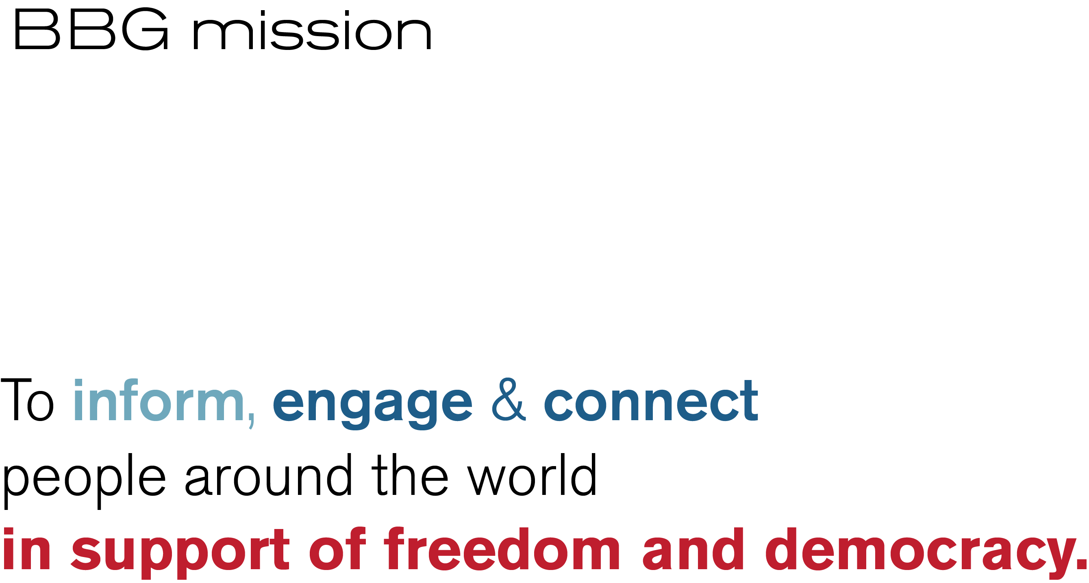
3
Notes:
The BBG impact model is directly derived from the BBG’s mission statement. We divide impact assessment into three pillars: (1)Inform, (2) engage/connect, and (3) be influential (in support of freedom and democracy).

Slide 4
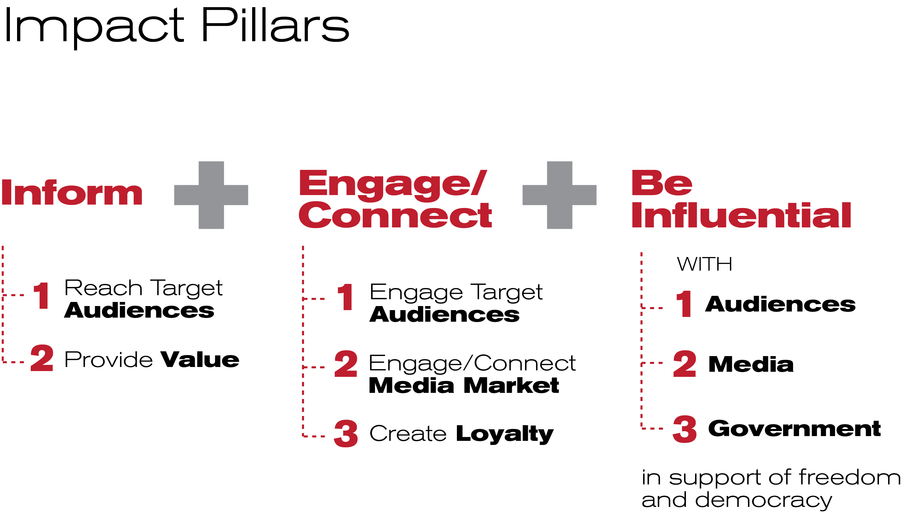
4
Notes:
We have impact goals associated with the pillar.
Altogether, the impact model has 3 pillars, 8 goals, and 11 core impact indicators and 28 optional impact indicators under these goals. Core applies to all markets and all entities (for denied areas, other data sources may be substituted for representative survey based indicators)

Slide 5
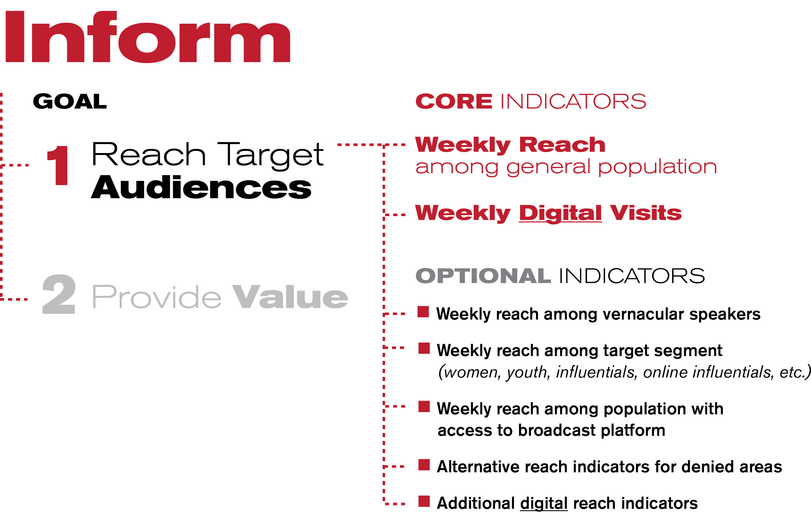
5
Notes:
Let’s take a closer look at how this works out in practice. On pillar 1—inform– our first goal is to reach target audiences. We have two CORE indicators here. First, weekly reach among the general population. This indicator is measured through nationally representative surveys in most markets. There are some markets—we call them denied areas– where we cannot conduct representative in-country surveys. For those markets only, representative survey data may be substituted by alternative data sources, such as non-representative refugee/ traveler surveys, qualitative research, or anecdotal evidence.
Our second core indicator is weekly digital visits—this metric comes from Adobe Analytics.
There are also a series of OPTIONAL indicators. Optional means these indicators are only applicable to certain market realities or certain entity specific mission elements. Let’s pick the third indicator to illustrate. It measures “weekly reach among population with access to broadcast platform” This indicator is important in markets where key distribution platforms are blocked to the BBG. For example in Russia, we are no longer permitted to reach audience through FM or AM radio, and are only able to get very limited TV affiliations due to potential repercussions of partnering with the BBG. In Russia, we would hence look at our reach among the portion of the population that regularly use the internet or satellite TV, which are our main distribution platforms there.

Slide 6
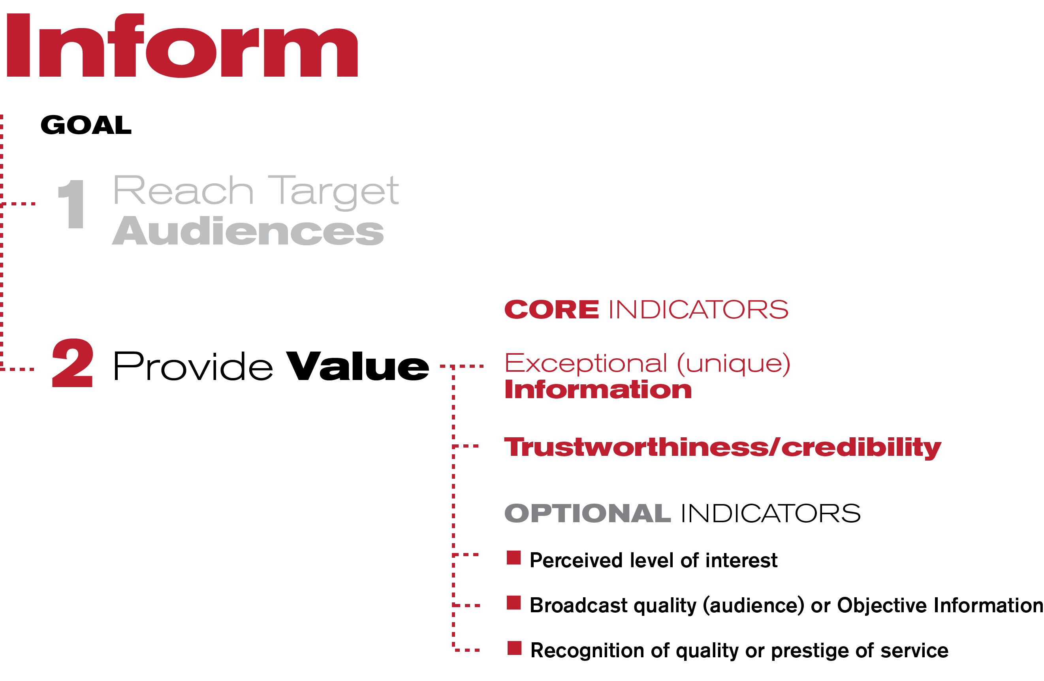
6
Notes:
The second goal of the inform pillar is to provide value. We assess our impact in providing value by two core indicators, (1) whether we provide exceptional information, and (2) whether our audiences trust our programs. There are also several optional indicators.

Slide 7
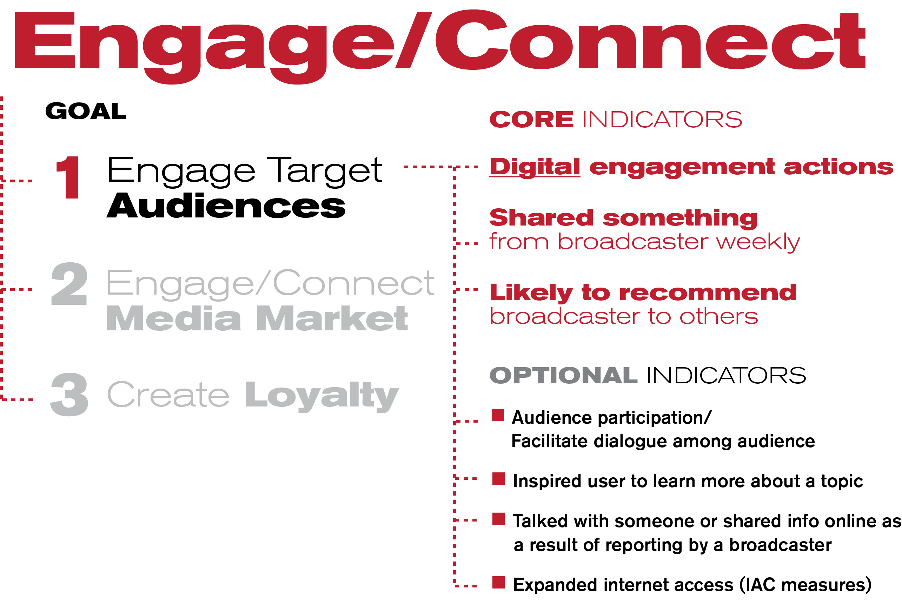
7
Notes:
When we assess our first goal –to engage target audiences– in the engage/connect pillar, we look at three core indicators: (1) digital engagement action on social media sites such as Facebook and Twitter, (2) in our surveys, we ask our audiences if they shared something from a BBG broadcaster in the past week, and (3) if they would recommend the BBG broadcaster to others. Again, we also have several optional indicators.

Slide 8
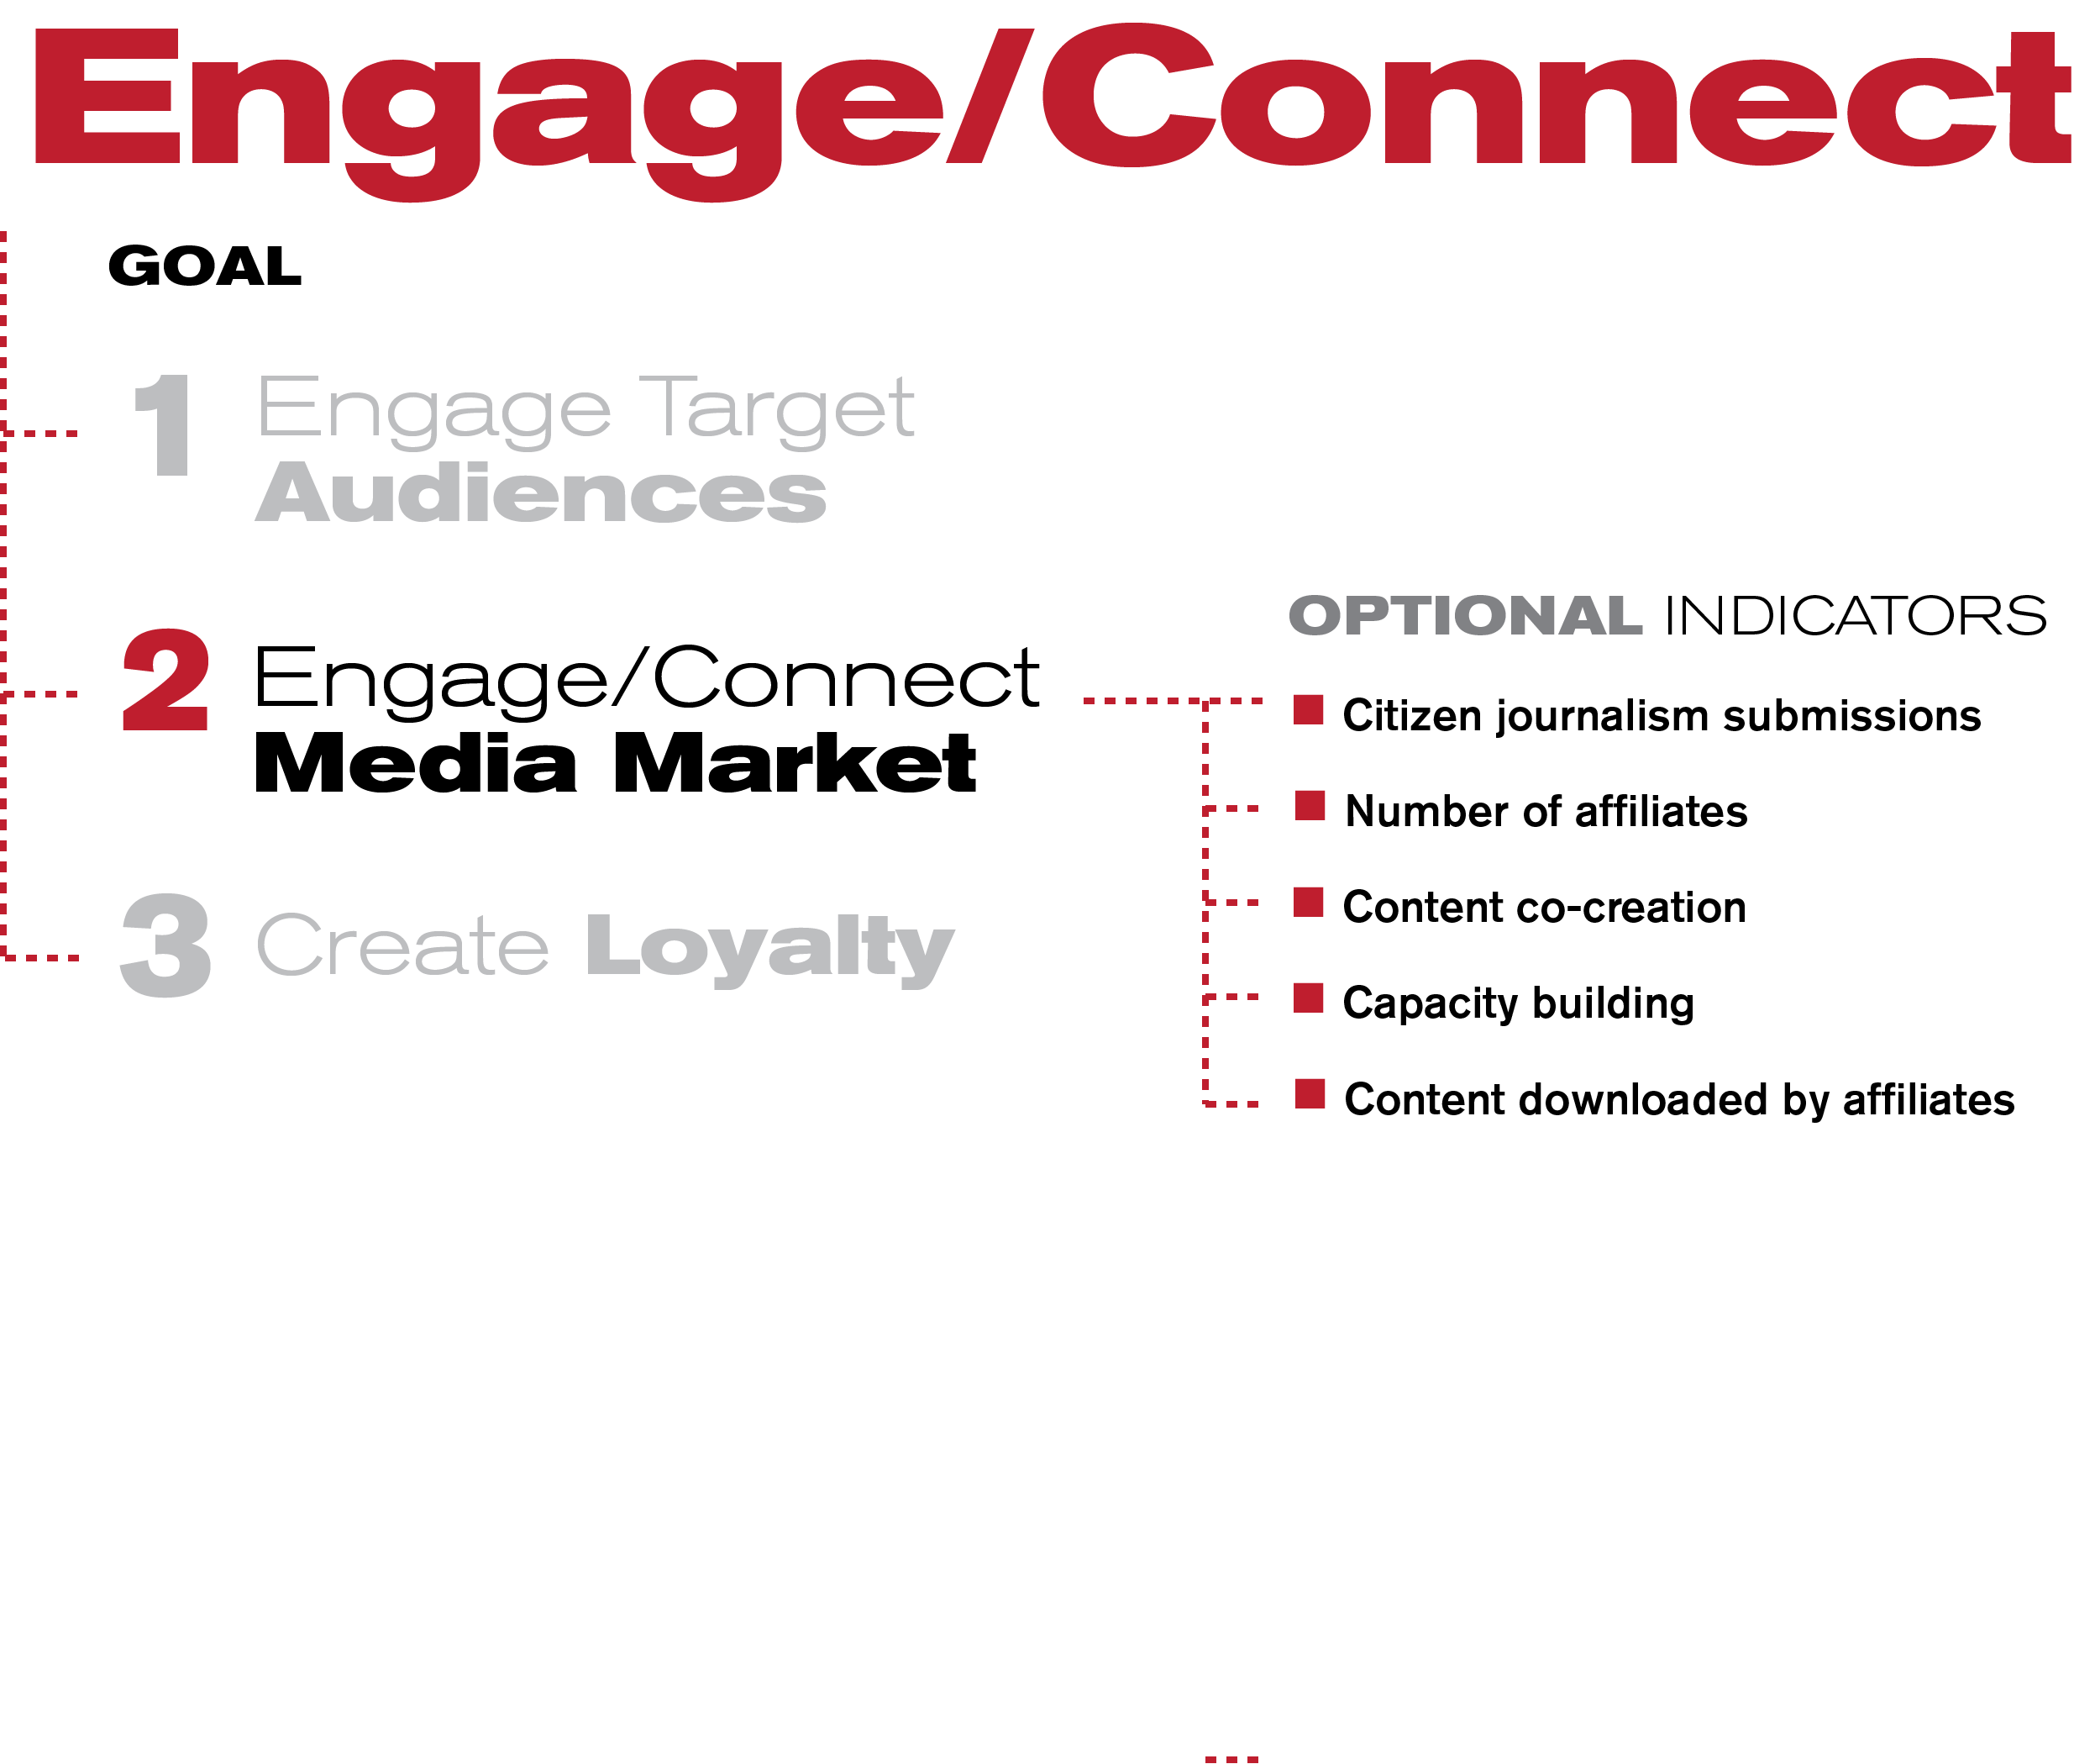
8
Notes:
The second goal of the engage/connect pillar to engage/connect the media market. The indicators here are all optional, because we are not able to perform these in all markets.

Slide 9
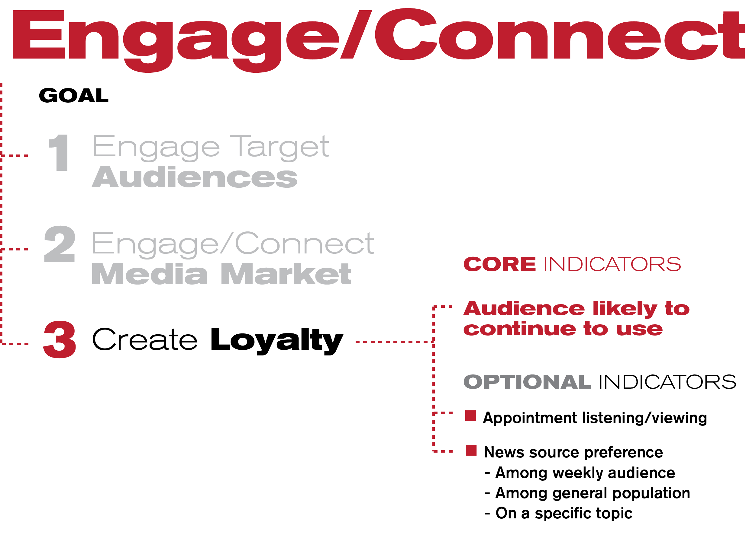
9
Notes:
The final goal of the engage/ connect pillar is to create loyalty. Our core indicator assesses if our audiences are likely to continue to use our content in the future.
There is also a series of optional indicators.

Slide 10
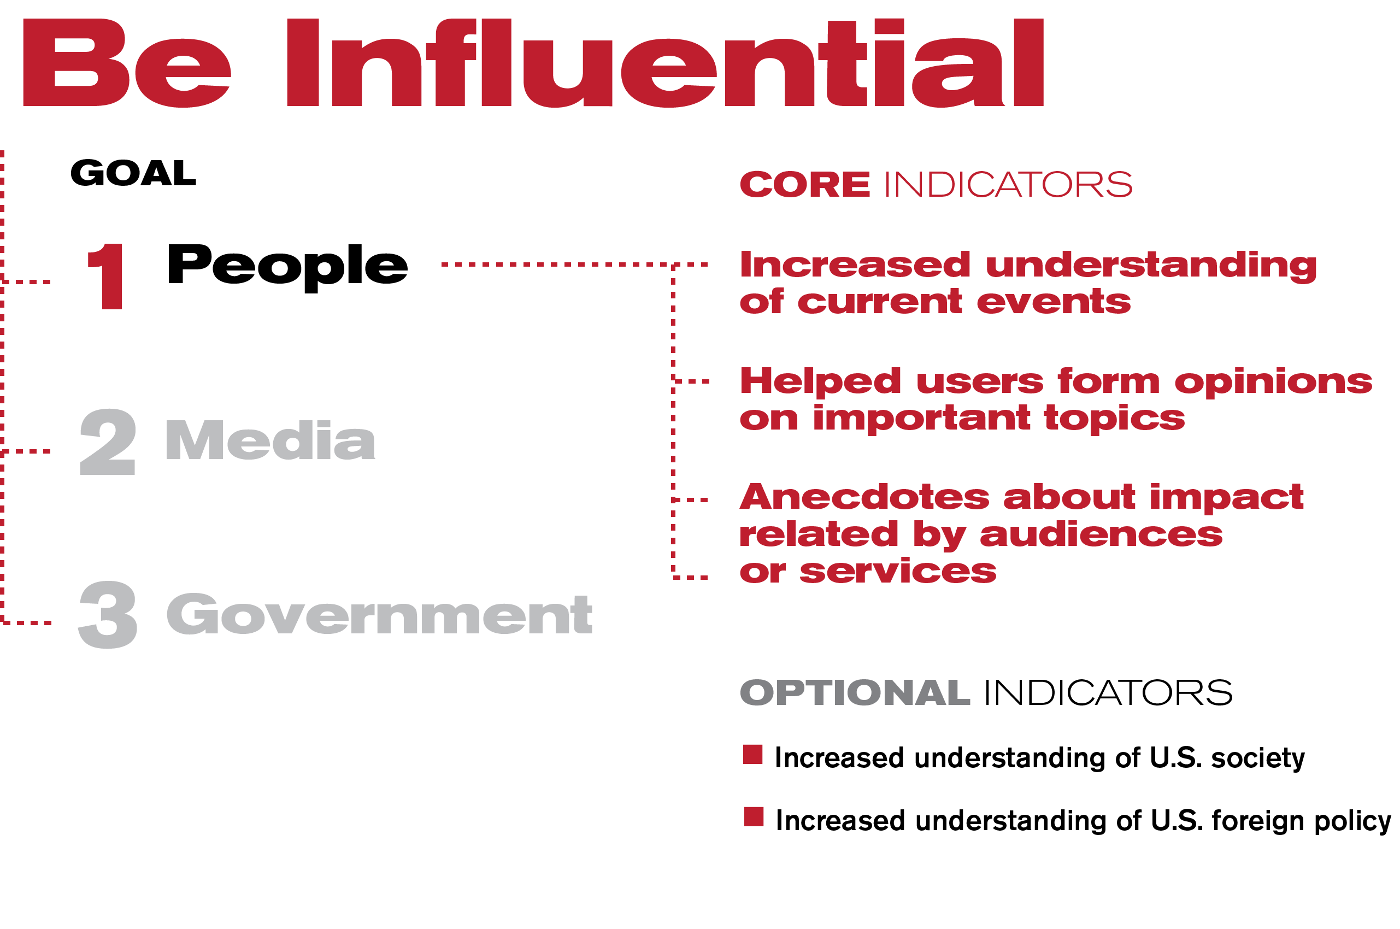
10
Notes:
Our final pillar is to be influential (in support of freedom and democracy.) Our first goal is to be influential with people, and we assess our impact here with three core indicators and some optional indicators.

Slide 11
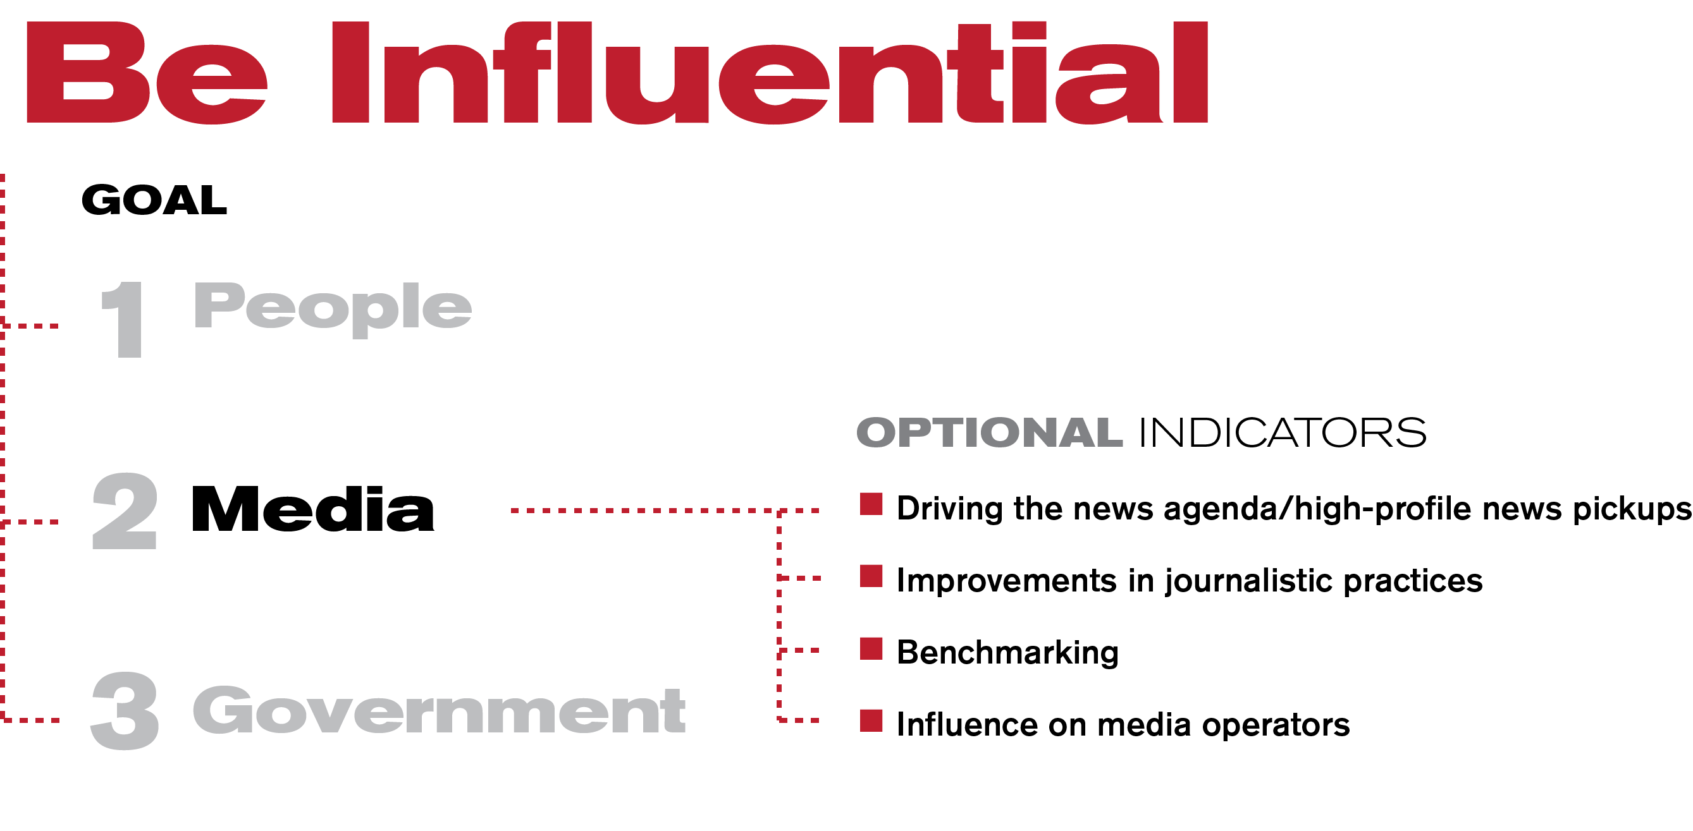
11
Notes:
For our second goal, to be influential with media, we are looking at several optional indicators.

Slide 12
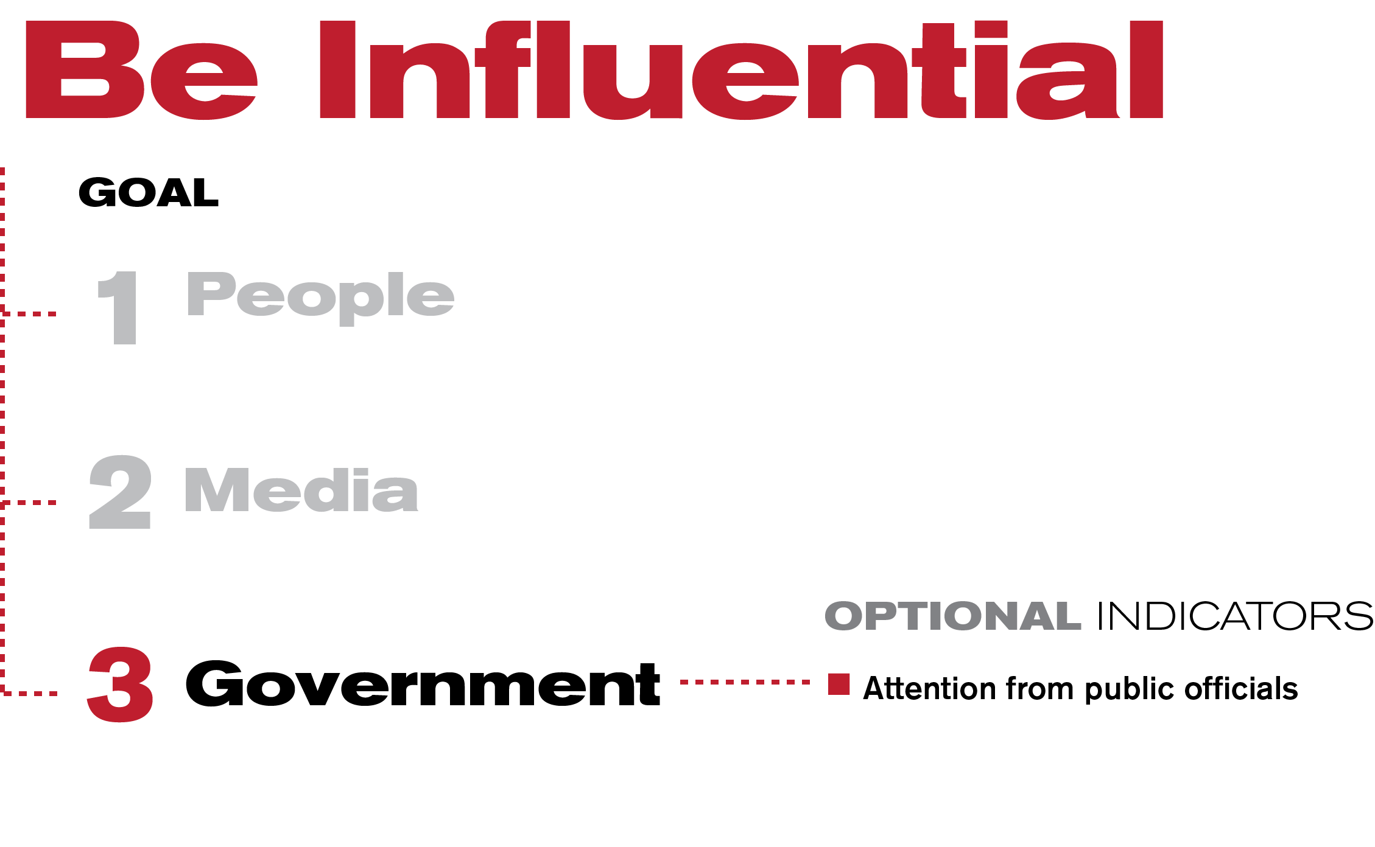
12
Notes:
To be influential with governments is our final goal. We assess if we receive positive or negative (jamming etc.) attention from public officials, if there are legislation or other initiatives underway based on our reporting etc.

Slide 13
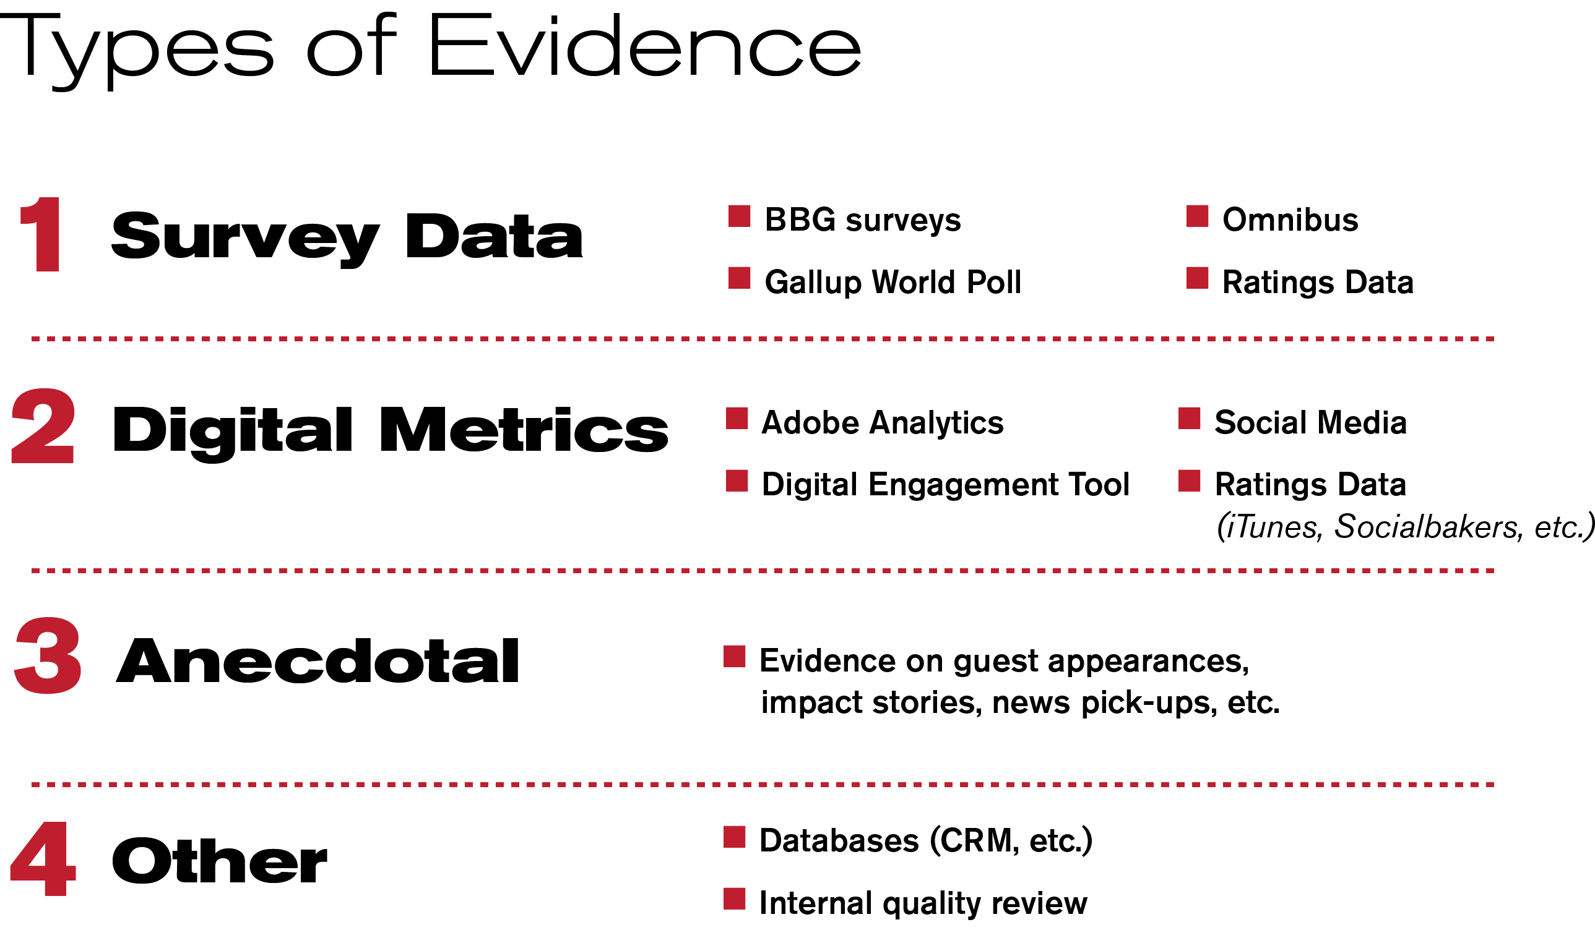
13
Notes:
We use four types of evidence to assess the indicators in our impact model.

Slide 14
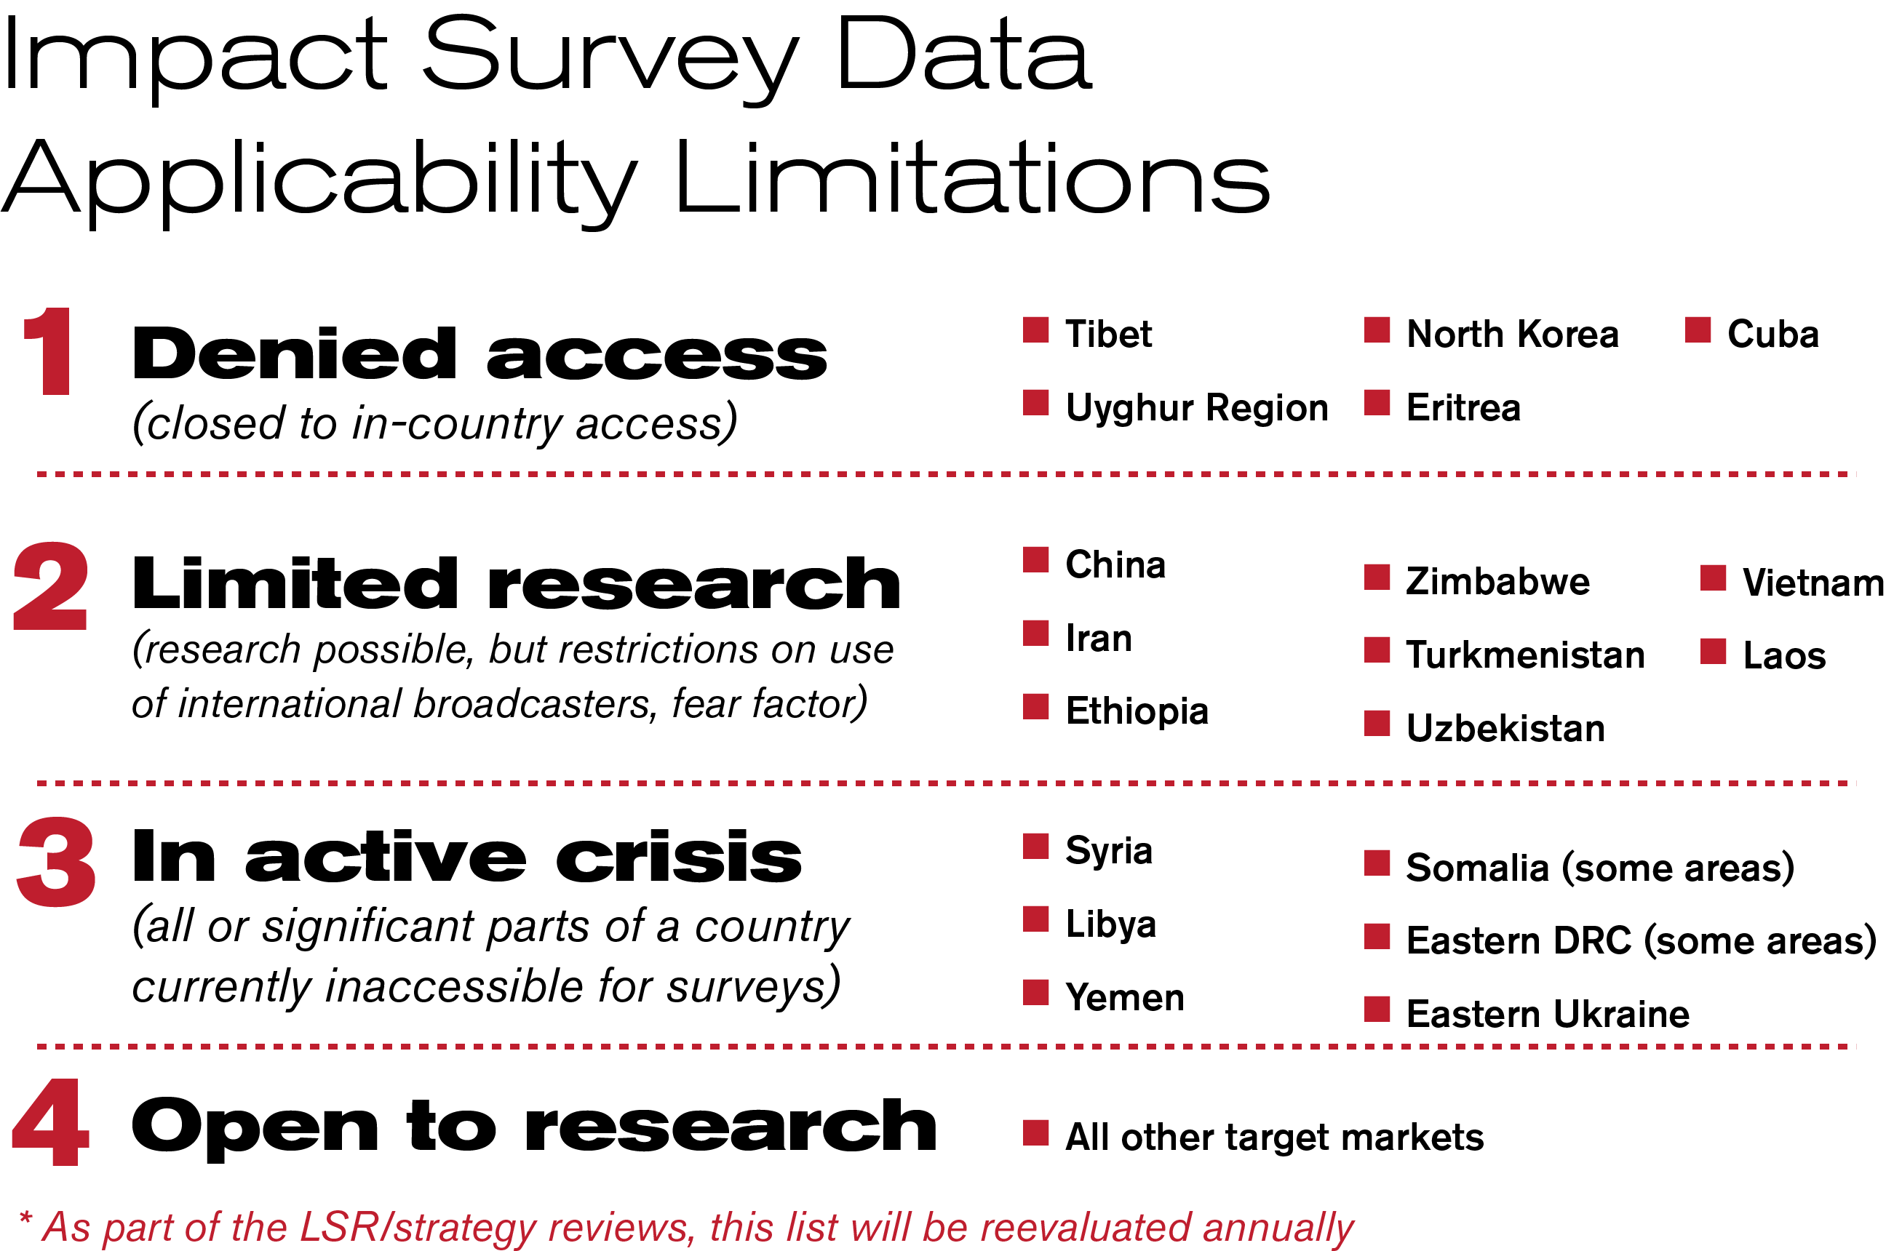
14
Notes:
Data source for denied areas: traveler surveys/refugee surveys, qualitative research, anecdotal evidence
Cuba may move off the list this year—we are exploring a representative survey there

Slide 15
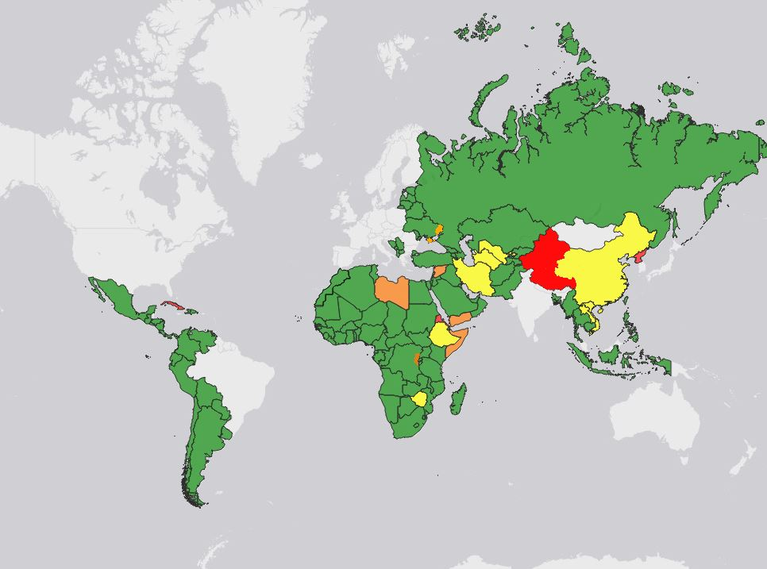
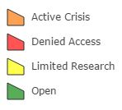
World Map by Research Status
15
Notes:
Countries in gray are not BBG target markets

Slide 16
Impact Model Example
Ukraine

Slide 17
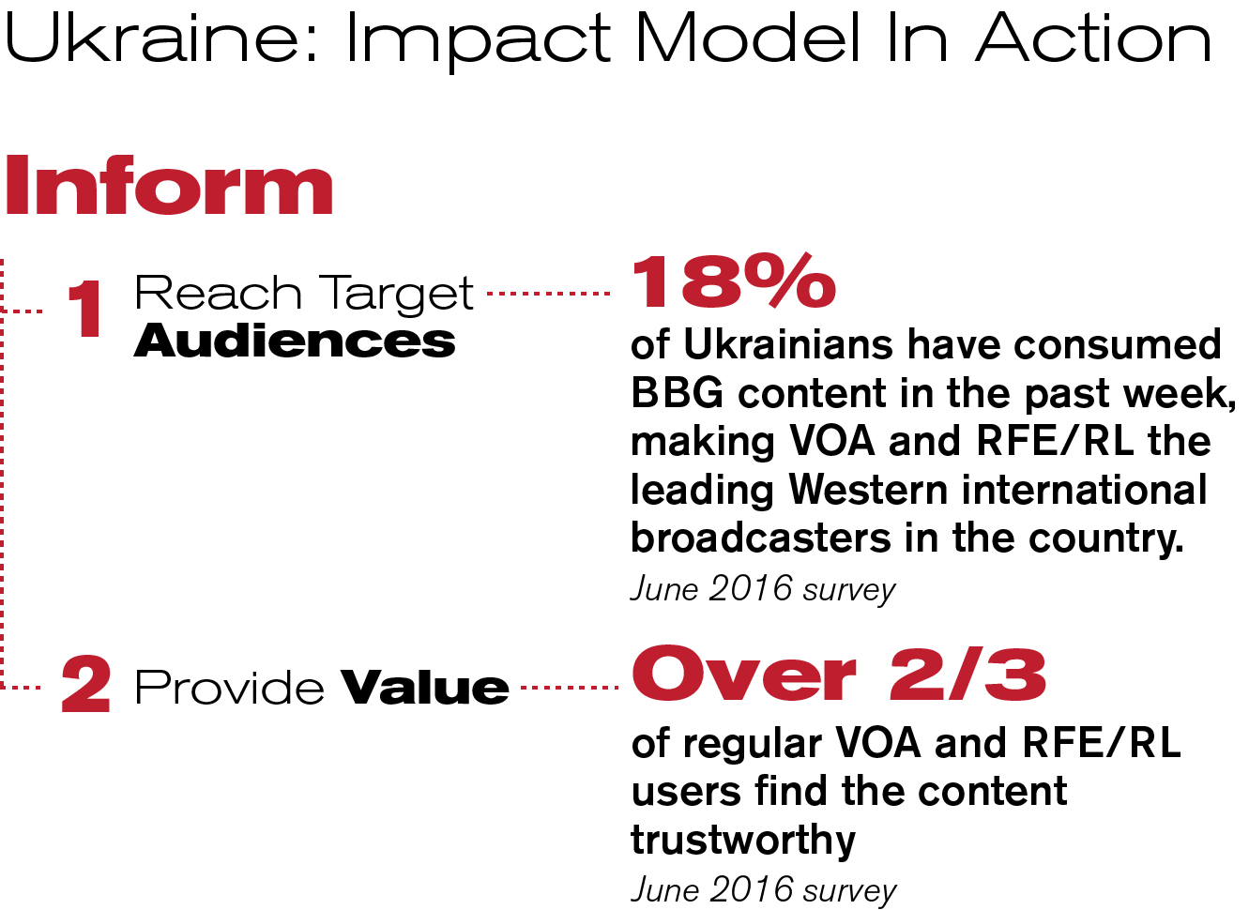

Slide 18
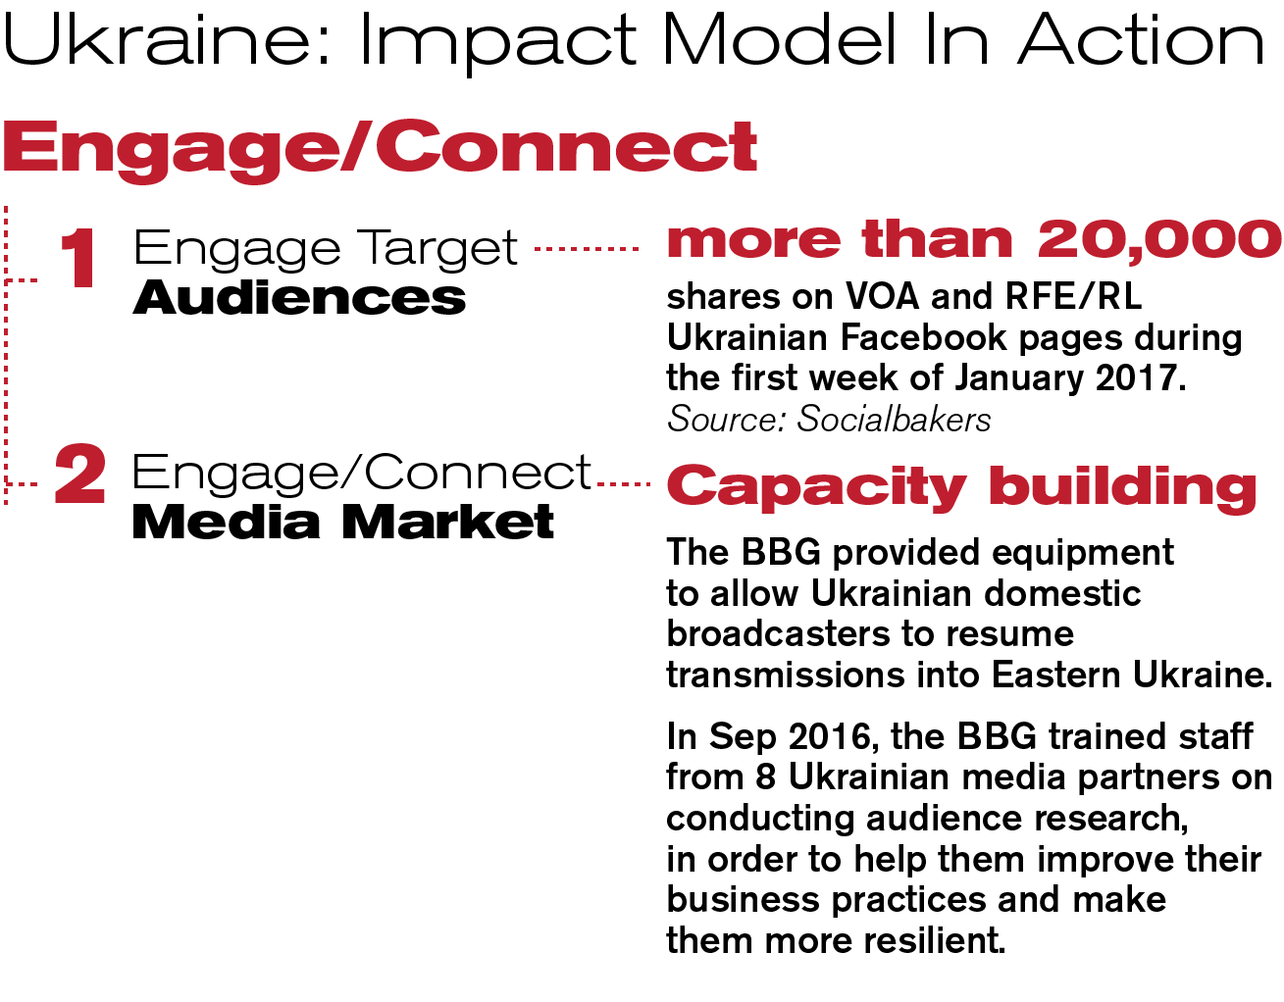

Slide 19
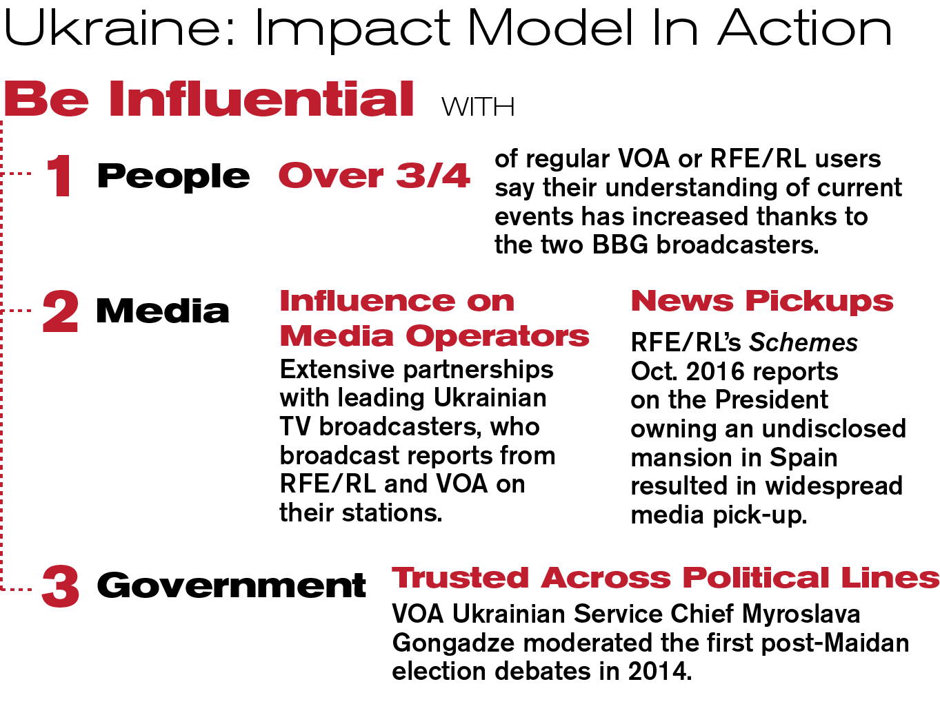

Slide 21
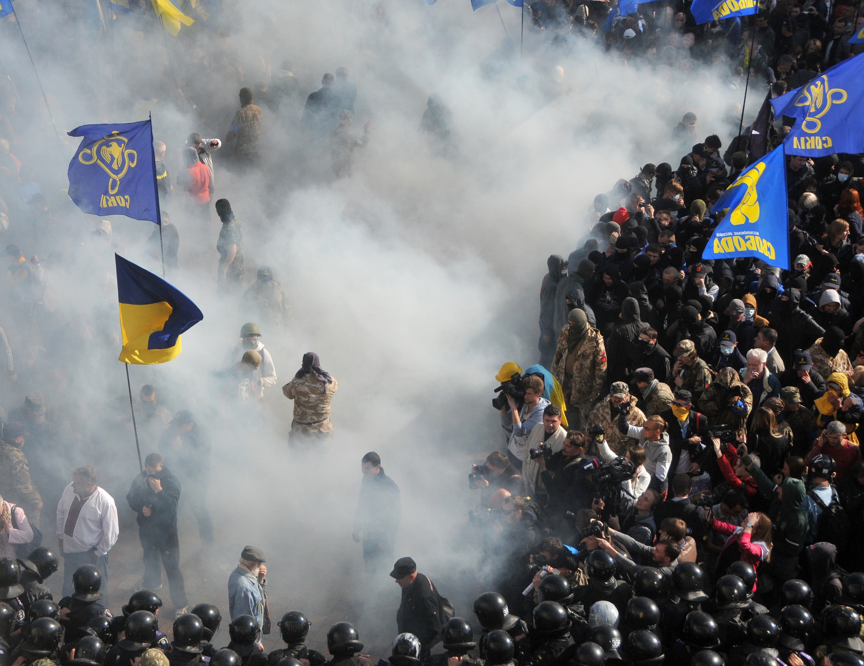

Media Sustainability Index
Measuring Media Performance

Slide 22

Measuring Media: a Development Context
Free Speech
Professional Journalism
Plurality of News Sources
Business Management
Supporting Institutions

Slide 23
Objective 2: Professional Journalism
Journalism Meets Professional Standards of Quality
1. Reporting is fair, objective, and well-sourced
2. Journalists follow recognized and accepted ethical standards
3. Journalists and editors do not practice self-censorship
4. Journalists cover key events and issues
5. Pay levels for journalists and other media professionals are sufficiently high to discourage corruption and retain qualified personnel within the media profession
6. Entertainment programming does not eclipse news and information programming
7. Facilities and equipment for gathering, producing, and distributing news are modern and efficient
8. Quality niche reporting and programming exist (investigative, economic/business, local, political)

Slide 24
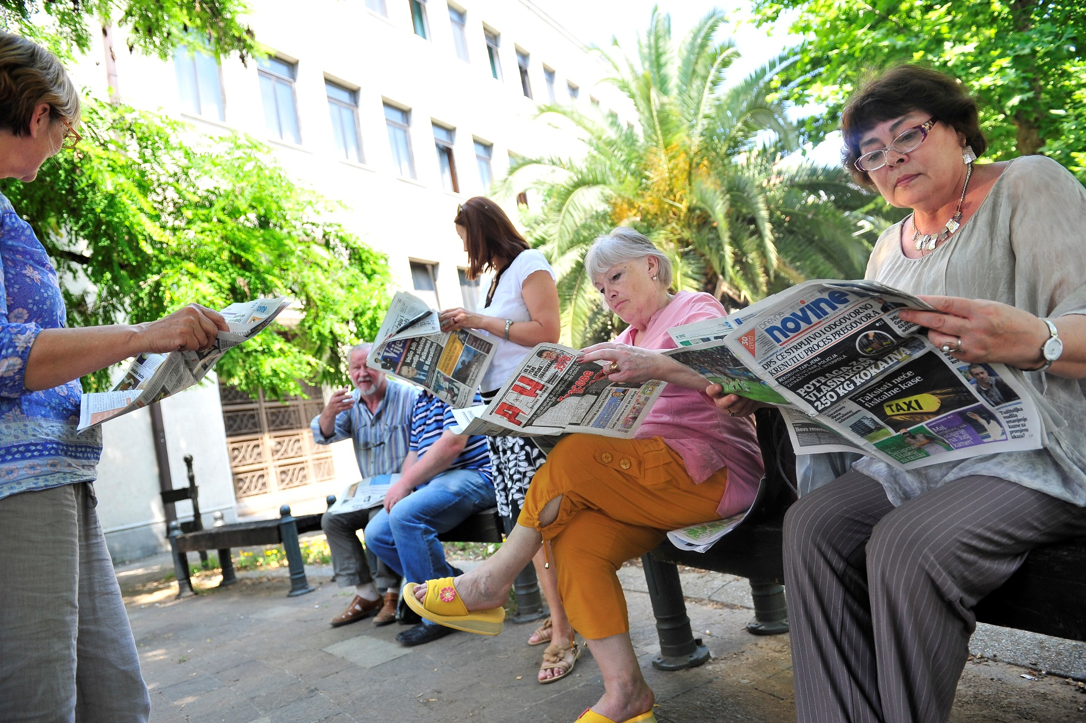
Public’s Perspective
Objective 6:
The Media Serve Citizens by Providing Useful and Relevant News and Information and Facilitating Public Debate

Slide 25
Meaning of Scores
Unsustainable, Anti-Free Press (0-1): Country does not meet or only minimally meets objectives. Government and laws actively hinder free media development, professionalism is low, and media-industry activity is minimal.
Unsustainable Mixed System (1-2): Country minimally meets objectives, with segments of the legal system and government opposed to a free media system. Evident progress in free-press advocacy, increased professionalism, and new media businesses may be too recent to judge sustainability.
Near Sustainability (2-3): Country has progressed in meeting multiple objectives, with legal norms, professionalism, and the business environment supportive of independent media. Advances have survived changes in government and have been codified in law and practice. However, more time may be needed to ensure that change is enduring and that increased professionalism and the media business environment are sustainable.
Sustainable (3-4): Country has media that are considered generally professional, free, and sustainable, or to be approaching these objectives. Systems supporting independent media have survived multiple governments, economic fluctuations, and changes in public opinion or social conventions.

Slide 26
Ukraine: Freedom of Speech

Slide 27
Ukraine: Professional Journalism

Slide 28
Ukraine: Plurality of News Sources

Slide 29
Ukraine: Business Management

Slide 30
Ukraine: Supporting Institutions

Slide 31
Ukraine: Serving Public Needs
1.85

Slide 32
Ukraine: What Media Panelists Say
Media organizations do not publicize the fact that stories are editorial or paid, especially during election campaigns.
“In Zhytomyr’s media, we found up to 40 percent of the advertising to be improperly marked,” Steblyna said. “In online media, the advertisements are hidden under subheadings, such as ‘company news’ and ‘politics.’”

Slide 33
Ukraine: What the Public Says
Nesterenko stated that poor quality content hampered people’s ability to make conscious choices. “To keep audiences hooked, the media offer more emotionally charged content, which prevents analysis and critical thinking. This is ruinous.”
Panych remarked, “Our Ukrainian media are very influential, and—simultaneously—effectively manipulative. And that is the biggest threat to informational security of our country.”

