Slide 2
BBG Research Series
Media Consumption in Turkey

Slide 3
Turkey
Findings From the World Poll
Benjamin Ryan, Research Consultant, Gallup

Slide 4
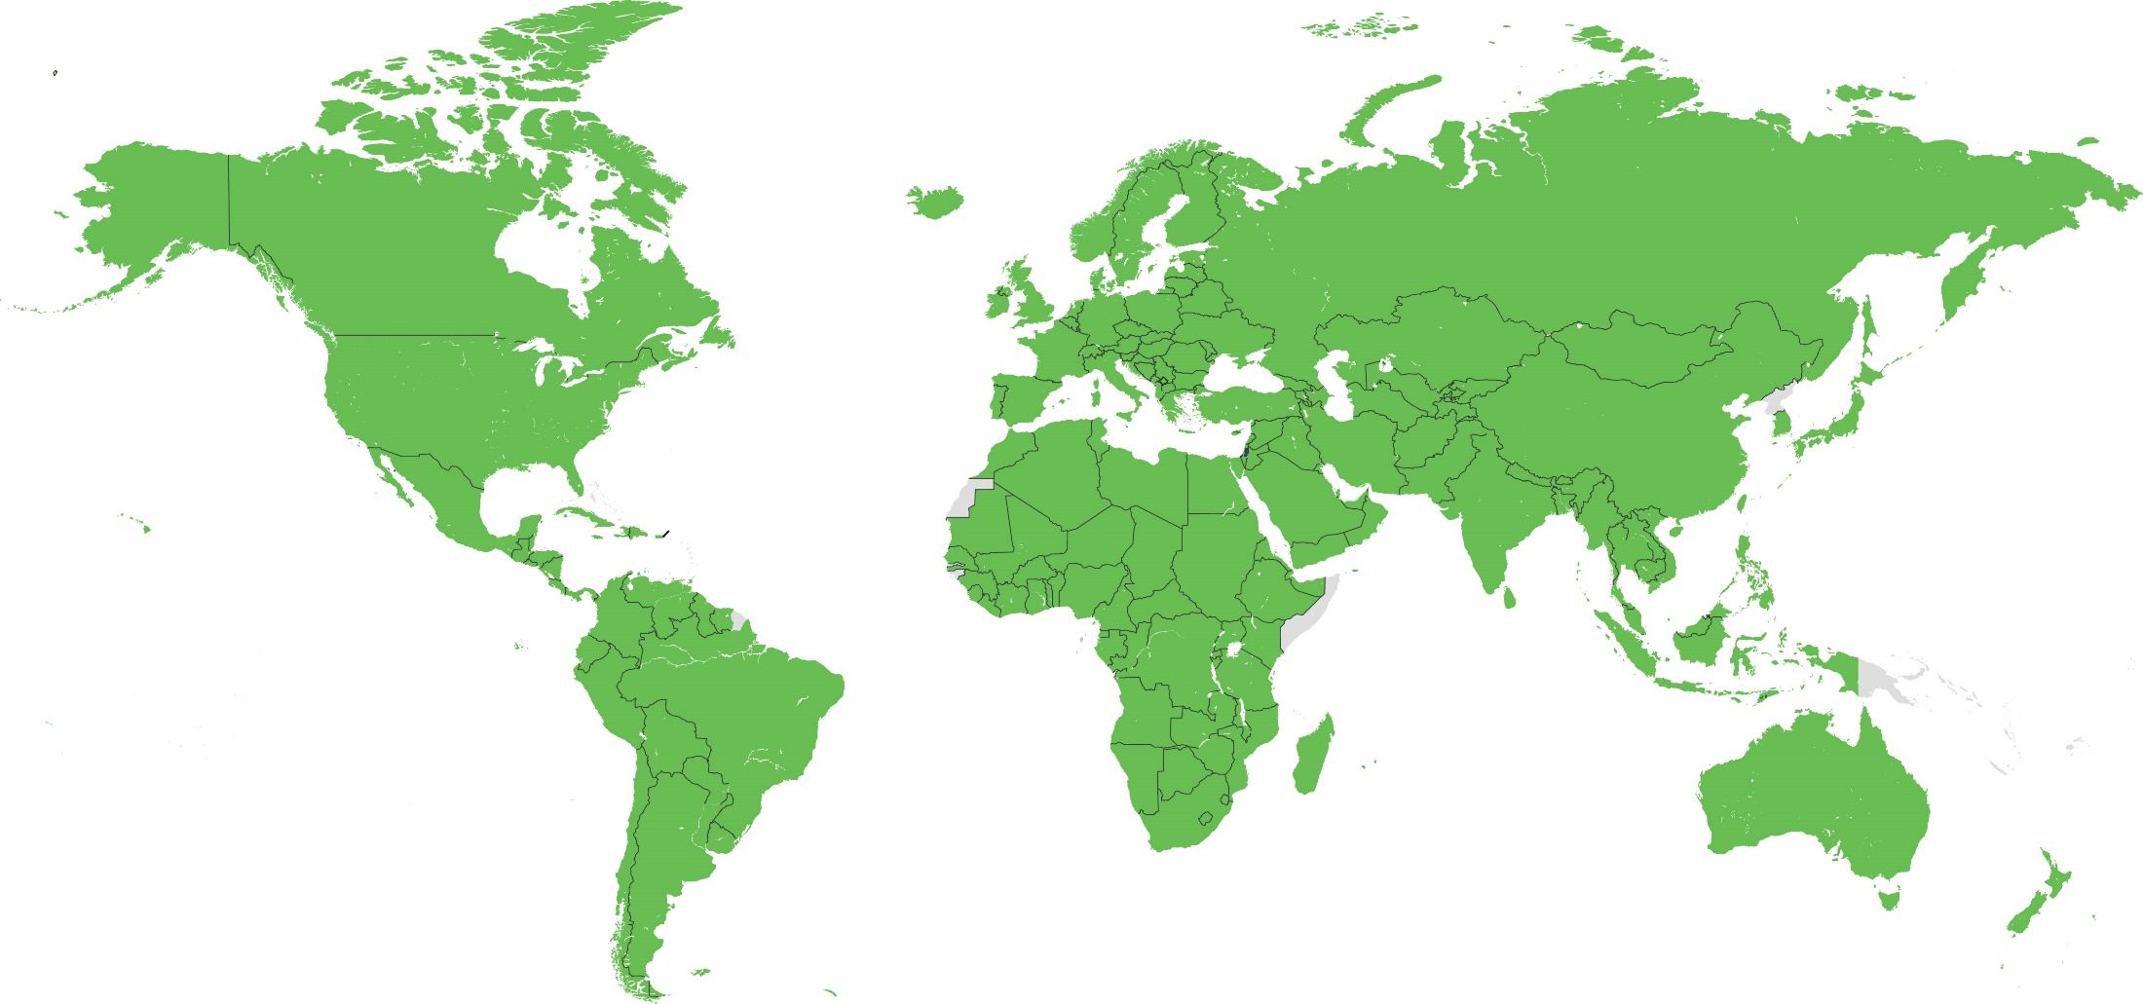
Gallup World Poll Coverage
Copyright © 2013, 2017 Gallup, Inc. All rights reserved.

Slide 5
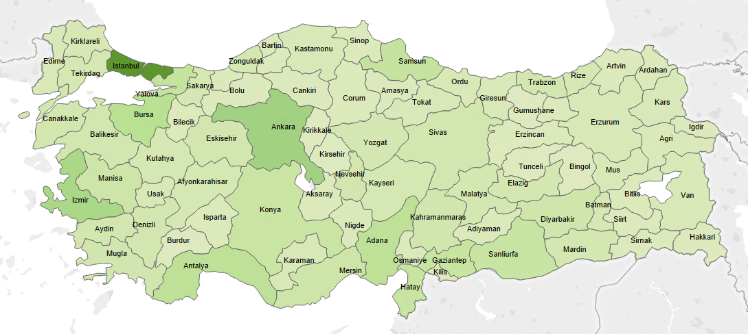
Gallup World Poll Methodology
Nine waves of face-to-face surveys 2005-2013
Four waves of phone surveys 2014-2016
Last survey: April 2016
Nationally representative of all adults 15* years and older
Sample size: Approximately 1,000 per survey
MoE ± 3.2-3.8 percentage points
Copyright © 2015, 2017 Gallup, Inc. All rights reserved.

Slide 6
Gallup World Poll in Turkey, 2016
Copyright © 2015, 2017 Gallup, Inc. All rights reserved.

Slide 7
Confidence in Security and Legal Institutions
Copyright © 2017 Gallup, Inc. All rights reserved.
Notes:
Confidence in Military is highest, as in many countries
Confidence in Police has trended up
Confidence in Judicial System has trended down, especially starting in 2010
Confidence in National Government has been relatively steady at 50-60%

Slide 8
Confidence in the Judicial System
■ Yes | ■ No | ■ (DK)
Education Levels
Income Quintiles
Copyright © 2017 Gallup, Inc. All rights reserved.

Slide 9
Confidence in Local Police
■ Yes | ■ No | ■ (DK)
Age Groups
Education Levels
Copyright © 2017 Gallup, Inc. All rights reserved.

Slide 10
Confidence in Military
■ Yes | ■ No | ■ (DK)
Age Groups
Education Levels
Copyright © 2017 Gallup, Inc. All rights reserved.

Slide 11
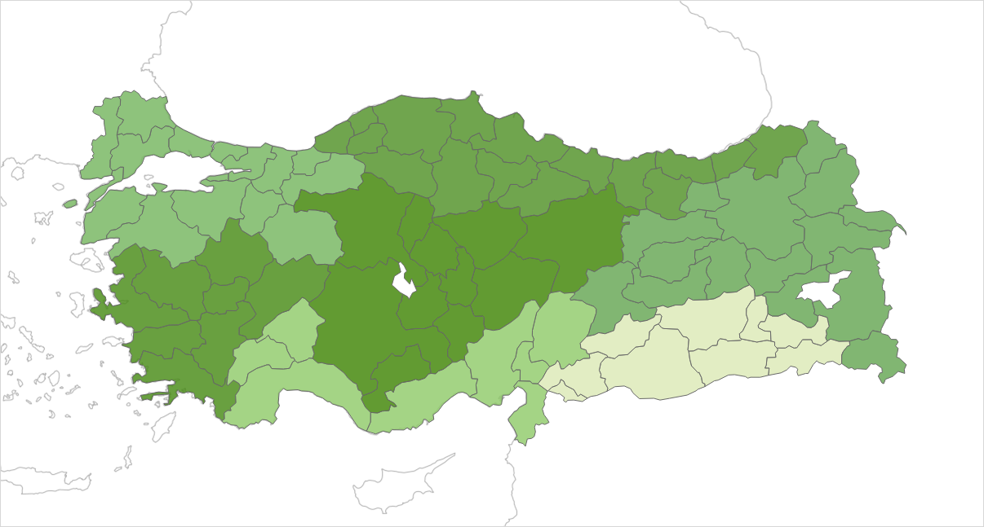
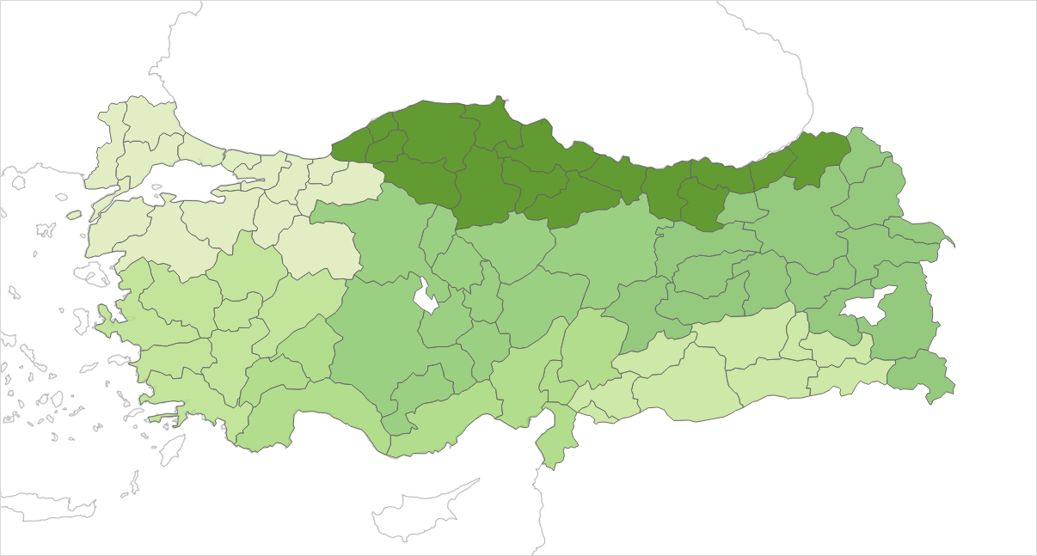
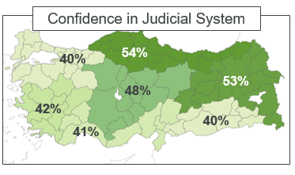
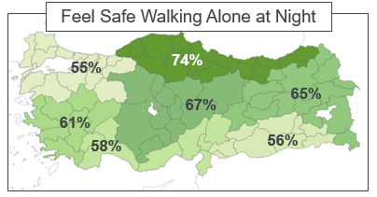
Confidence in Security/Legal Inst., by Region
Confidence in Military
Confidence in Local Police
82%
87%
71%
89%
84%
80%
89%
79%
88%
74%
73%
73%
79%
76%
54%
74%
Copyright © 2017 Gallup, Inc. All rights reserved.

Slide 12
Economic Perspectives
Copyright © 2015, 2017 Gallup, Inc. All rights reserved.
Notes:
Since 2009, general improvement in views on Economic conditions, job market, standards of living

Slide 13
Measuring Life Evaluation
Gallup tracks the prevalence of three categories based on respondents’ present and future life ratings on a 0 to 10 scale:
Thriving | Struggling | Suffering
Respondents have positive views of their present life situation (7+) AND a positive view of where their lives will be in five years (8+).
Respondents have moderate to negative views of their present life situation OR moderate to negative views of where their lives will be in five years.
Respondents have negative views of their current life situation (4 or below) AND negative views of where their lives will be in five years (4 or below).
Copyright © 2015, 2017 Gallup, Inc. All rights reserved.

Slide 14
Economic Perspectives, by Age and Education
■ Getting Better | ■ (The same) | ■ Getting Worse
■ Good Time | ■ Bad Time | ■ (DK)
■ Thriving | ■ Struggling | ■ Suffering
■ Excellent | ■ Good | ■ Only Fair | ■ Poor
Copyright © 2017 Gallup, Inc. All rights reserved.
Notes:
Older adults more likely to say their standard of living is declining/staying the same, 2/3 of youngest say it’s getting better.
Youngest also more likely to be “Thriving,” oldest most likely to be “suffering.”
Less educated are more positive about job prospects, economic conditions generally.

Slide 15
Confidence in Political Institutions
President
General
General
General
Local
Notes:
Confidence in Political Institutions has been relatively consistent over this period, despite some tumultuous changes and dramatic headlines.
In 2016, shortly before the failed coup, Erdogan had an approval rating of 58%, even with his approval ratings in 2014, and up from 50% in 2015.
Confidence in National Government is at the same level, and has tracked closely with Erdogan’s approval ratings, an indication of his central and powerful role.
Ratings of Corruption in Government have fallen in the past decade, from 65% to 46% today, even in the face of a major corruption scandal in late 2013.

Slide 16
Opinions of Political Institutions, by Education
■ Approve | ■ Disapprove | ■ (DK)
■ Yes | ■ No | ■ (DK)
■ Approve | ■ Disapprove | ■ (DK)
■ Yes | ■ No | ■ (DK)
Copyright © 2017 Gallup, Inc. All rights reserved.
Notes:
More educated have much lower confidence overall
Approval of Erdogan is higher than “national leadership,” but also has more “DK/RF”
Corruption in Government has highest DK/RF, 25% overall saying “DK/RF,” steadily increasing from 11% in 2011.

Slide 17
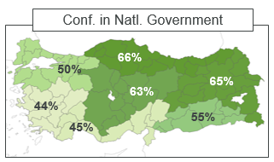
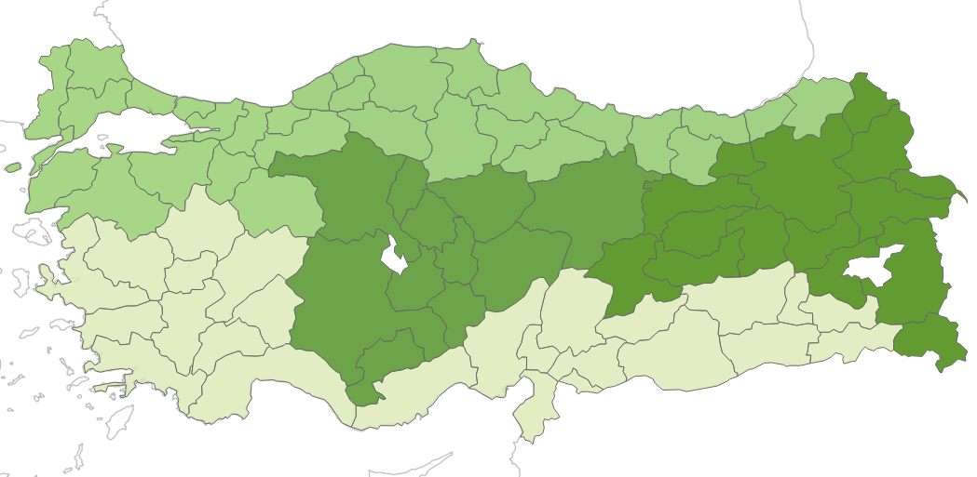
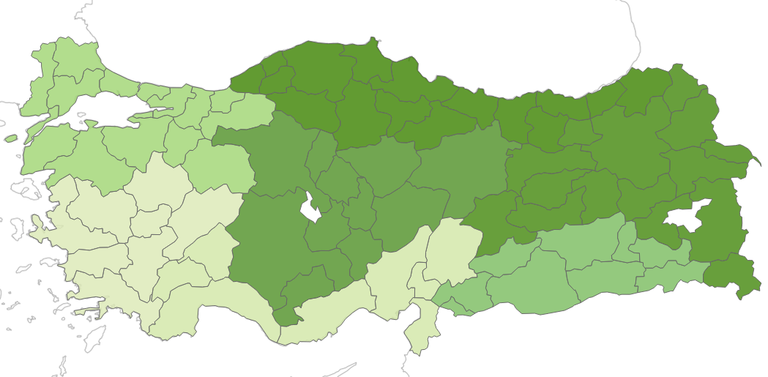
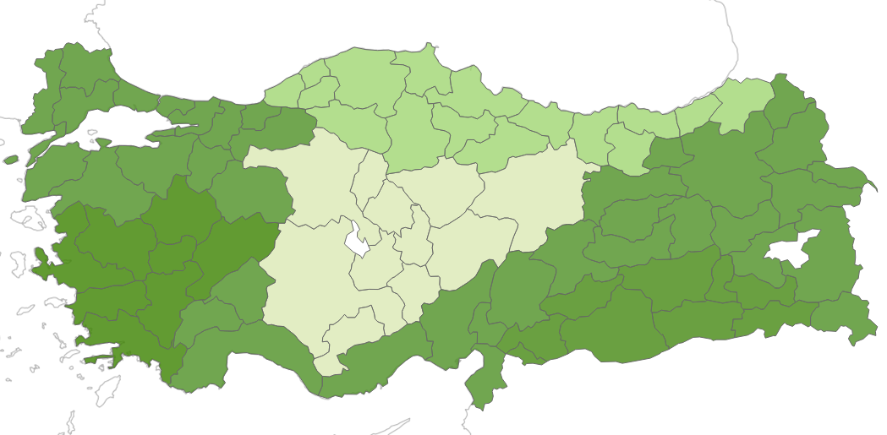
Confidence in Security/Legal Inst., by Region
Approval of Natl. Leadership
48%
49%
52%
61%
53%
59%
48%
41%
41%
41%
Approval of Erdogan
Corruption in Government
52%
61%
44%
53%
64%
68%
53%
40%
46%
55%
54%
53%
54%
43%
Copyright © 2017 Gallup, Inc. All rights reserved.

Slide 18
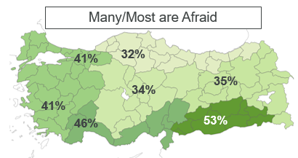
Political Freedoms – Fear of Expression
Fear of expressing political views has declined in recent years, but remains high in Southeast Anatolia.
Decrease in fear of expression spans demographics – age, gender, education, income, etc.
No surveys conducted since the coup and purges this year, however.
53%
Copyright © 2015, 2017 Gallup, Inc. All rights reserved.

Slide 19
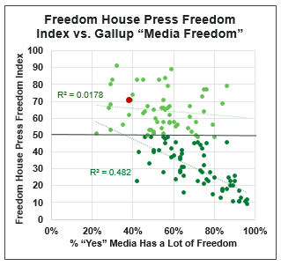
Freedom of Media — April 2016
“These are dark days for journalism in Turkey. The latest press freedom index by Reporters Without Borders puts the country in 151st place, between Tajikistan and the Democratic Republic of Congo. Censorship is the industry standard.” – The Economist, May 2016
Copyright © 2015, 2017 Gallup, Inc. All rights reserved.
Notes:
According to Freedom House, Press Freedom in Turkey has been getting steadily worse in recent years (higher index values indicate less press freedom)
Gallup “Media has a lot of Freedom” has been relatively steady, though 2015 and 2016 are showing lower numbers.
NOTE: countries scoring above 50 on the Freedom House Index show almost no relationship to Gallup’s Media Freedom measure, while those that score below 50 have a strong relationship.

Slide 20
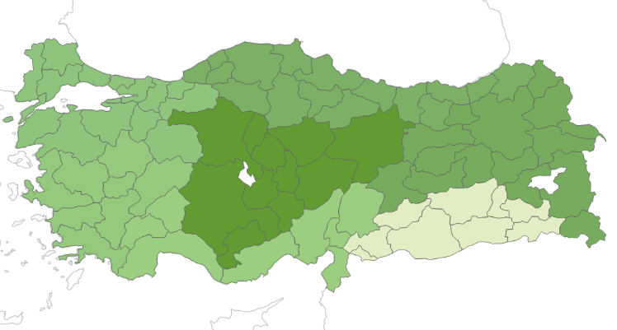
Freedom of Media — April 2016
Gender
Age
Education
38%
42%
47%
43%
37%
36%
27%
Income
Urbanicity
Region
Copyright © 2015, 2017 Gallup, Inc. All rights reserved.
Notes:
Between 2013-14 and 2015-16, belief in media freedom fell the most among 18-24 year olds, the poorest and richest segments, rural residents, and men.
Overall, belief in media freedom decreases with education, and is strongest in Central and Eastern Anatolia and the Black Sea Region.

Slide 21
Key Takeaways
Confidence in Military is consistently high
Lower among youth, college educated, and Southeast Anatolia but never below 75%.
Confidence in Judicial System has fallen, while confidence in Police has risen.
Those with the highest education have the lowest confidence
Confidence is highest in Central, North and Eastern areas
Economic outlook has gotten better since 2009
Younger Turks, Less Educated are the most positive
Confidence in Political Institutions has been relatively consistent over this period, despite all the changes
More educated have lower confidence, approval in leadership
Central/North/Eastern regions have higher confidence, approval ratings
Fear of expressing political opinions has been declining, but still higher in Southeast
Belief in Media Freedom declining, especially among Youth, rural residents
Copyright © 2017 Gallup, Inc. All rights reserved.

Slide 22
Media Consumption in Turkey
William Bell, Director of Research, Voice of America
Copyright © 2017 Gallup, Inc. All rights reserved.

Slide 23
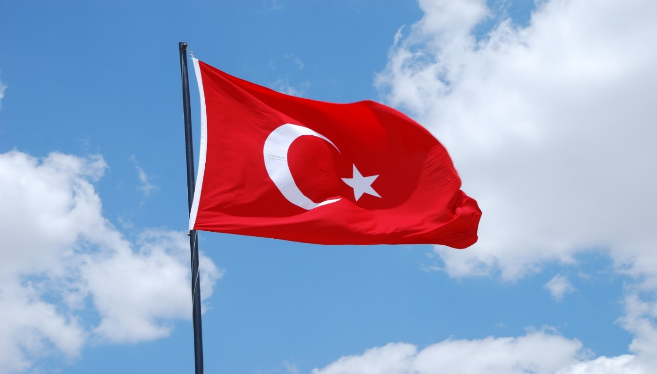
National Survey of Turkey
CATI-administered
Sample size =1,700
Both landline and mobile phones sampled
Sample included 200 Kurdish speakers
May-June, 2016
No geographical exclusions
Copyright © 2017 Gallup, Inc. All rights reserved.

Slide 24
Overview
Turkey is among the most developed media markets for BBG.
Dozens of TV stations; hundreds of radio stations; access to digital media and satellite TV are ubiquitous.
Political events have led to a major reduction in media freedom, sharply escalating after attempted coup of July 2016.
Reporters without Borders cites jailing of over 100 journalists, closure of 149 media outlets.
Internet censorship remains widespread.
Copyright © 2017 Gallup, Inc. All rights reserved.

Slide 25
Perceived Importance of Following News
Percent saying it is “very important” to follow the news
Copyright © 2017 Gallup, Inc. All rights reserved.

Slide 26
Media Platforms Used Daily for News
Percentage of each group using platform daily for news
Copyright © 2017 Gallup, Inc. All rights reserved.

Slide 27
Top News Sources
Percentage naming station as one of top three news sources
Best Educated Respondents
All Respondents
Copyright © 2017 Gallup, Inc. All rights reserved.

Slide 28
Household Access to Media Equipment
Percentage of households with access
Copyright © 2017 Gallup, Inc. All rights reserved.

Slide 29
Types of Mobile Devices Owned
Base: Mobile phone owners (n=1,947)
Copyright © 2017 Gallup, Inc. All rights reserved.

Slide 30
How Internet is Accessed
Means of Accessing Internet in past 7 days.
Base: All past week Internet users (n=1,199)
Copyright © 2017 Gallup, Inc. All rights reserved.

Slide 31
Languages of Internet Access
Percentage of each group accessing Internet in languages shown.
Base: past week Internet users (n=1,199)
Copyright © 2017 Gallup, Inc. All rights reserved.

Slide 32
Main Internet Activities
Internet activities performed in past week.
Base: past week Internet users (n=1,199)
Copyright © 2017 Gallup, Inc. All rights reserved.

Slide 33
Website Used in Past Week
Base: Past week Internet users (n=1,199)
Copyright © 2017 Gallup, Inc. All rights reserved.

Slide 34
Selected Websites Used in Past Week
Percentage naming each site as one of top three Internet news sources.
Base: Past week Internet users (n=1,199)
Copyright © 2017 Gallup, Inc. All rights reserved.

Slide 35
Trust in Selected Stations
Base: All respondents expressing an opinion about each station; n’s as shown.
TRT (n=1,535)
Haberturk (n=1,495
TGRT Haber (n=1,404)
NTV (n=1,458)
CNN (n=1,392)
BBC (n=987)
Copyright © 2017 Gallup, Inc. All rights reserved.

Slide 36
Satisfaction with Turkish Media
Q. “How Satisfied are you with the information provided by Turkish media?”
Copyright © 2017 Gallup, Inc. All rights reserved.

Slide 37
Satisfaction with Media: 2016 vs. 2013
Copyright © 2017 Gallup, Inc. All rights reserved.

Slide 38
Past Week Use of Foreign Media
Percentage using BBC, CNN English, VOA, Bloomberg, France 24, CCTV, or Al Jazeera in past week
Copyright © 2017 Gallup, Inc. All rights reserved.

Slide 39
Past Week Use of Foreign Media X Satisfaction with Turkish Media
Level of satisfaction with Turkish media
Copyright © 2017 Gallup, Inc. All rights reserved.

Slide 40
Questions from the Survey
Views of Ideal Country
Q1. I am going to read you a list of phrases that might describe a country in the world. Please rate each phrase in terms of how important it is for a country to be described by that phrase. The rating scale is 1 to 9, in which 1 means it is not at all important for a country to be described by the phrase and 9 means it is very important for a country to be described by the phrase.
How Does the U.S. fit the Ideal?
Q2. Now, please rate each phrase
in terms of how well it describes
the United States. The rating
scale is 1 to 9, in which 1 means
the phrase does not describe the
United States at all and 9 means
the phrase describes the United
States very well..
Copyright © 2017 Gallup, Inc. All rights reserved.

Slide 41
Attributes of Ideal Country/U.S
 | Does not describe the U.S. at all | Describes the U.S. very well
Has good schools
Protects Human Rights
Different ethnic groups live peacefully
Good business/ economic opportunities
Provides disaster/ development aid
Is democracy with political freedoms
Fights cross national crime
Copyright © 2017 Gallup, Inc. All rights reserved.

Slide 42
Importance of Key National Attributes: In General and for U.S.
 | In General | U.S.
Has good schools | 8.22 | 7.41
Protects Human Rights | 8.08 | 4.92
Different ethnic groups live peacefully | 7.98 | 5.45
Good business/ economic opportunities | 7.97 | 6.91
Provides disaster/ development aid | 7.89 | 4.83
Is democracy with political freedoms | 7.6 | 6.19
Fights cross national crime | 7.45 | 4.77
Copyright © 2017 Gallup, Inc. All rights reserved.

Slide 43
Mean scores by age: Attributes of U.S.
 | 15-24 | 25+
Has good schools | 7.78 | 7.31
Protects human rights | 5.66 | 4.72
Different ethnic groups live peacefully | 5.76 | 5.36
Good business opportunities | 7.42 | 6.77
Provides disaster/development aid | 4.59 | 4.9
Is democracy with political freedom | 6.56 | 6.09
Fights cross national crime | 5.29 | 4.63
Copyright © 2017 Gallup, Inc. All rights reserved.

Slide 44
Overall Favorability Towards the U.S.
25+ (n=1,588)
15-24 (n=412)
All
Copyright © 2017 Gallup, Inc. All rights reserved.

Slide 45
Key Takeaways
Turks still have a large number of media outlets available to them, though press freedom is increasingly circumscribed.
A significant portion of the population – especially among the better educated -- express some degree of dissatisfaction with Turkish media.
No single media outlet enjoys clear dominance.
Widespread access to satellite TV and digital technologies means those who wish to can and do take advantage of foreign media.
Among younger Turks, Internet has become the #1 platform for news.
Attitudes towards the U.S. appear less negative than in much of the Islamic world, especially among younger Turks.

Slide 46
APPENDIX

Slide 47
Year | Developments in Turkey Prior to the Last Survey
2007 | April: In Ankara, tens of thousands protest Erdogan’s potential Presidential bid because of his Islamist background; Erdogan decides not to run. July: AKP wins parliamentary elections, Tayyip Erdogan becomes Prime Minster. October: Referendum to have president elected by popular vote, rather than parliament.
2008 | July: petition to ban AKP for allegedly undermining the secular constitution narrowly fails.
2009 | October: Turkey and Armenia agree to normalize relations.
2011 | June: AKP wins parliamentary elections again, PM Erdogan begins third term; Syrian refugees begin to pour in. August: President Abdullah Gul appoints military leaders after mass resignations.
2013 | June: Gezi Park and related protests overlapped with the survey fielding. August: Erdogan wins first popular election for president.
2014 | March: a court clears hundreds of military officers of involvement in alleged 2003 conspiracy against former PM Erdogan.
2015 | June: pro-Kurdish party enters elections, depriving AKP of majority. July: Syrian conflict ramping up against Islamic State, bombings escalate in Turkey.
2016 | March: Authorities put Turkey's biggest newspaper, Zaman under state control. Suicide car-bomb attack in Ankara kills 37 people. May: Ahmet Davutoglu resigns as prime minister after falling out with Erdogan.
Copyright © 2017 Gallup, Inc. All rights reserved.
Notes:
July 2009: President Abdullah Gul approves legislation proposed by the ruling AK Party giving civilian courts the power to try military personnel for threatening national security or involvement in organized crime.
September 2010: Referendum on constitutional reform backs amendments to increase parliamentary control over the army and judiciary.

